Slide 1
HAVE WHEELCHAIR
WILL TRAVEL!!!

Slide 2
Travel with Success
Planning Your Trip
Knowing Your Rights
Packing for Your Trip
Arriving at the Airport
Taking Off
Arriving at Your Destination
Relax & Enjoy!!!!!
Notes:
Topics to be addressed during this session include:
Planning for your trip: what are the resources that exist to refer to so that you are the most prepared for getting questions answered and making your trip trouble-free
Knowing your rights: What laws protect your right to fly and receive air travel accommodations
Packing for your trip: What are the essential items you should be thinking about bringing?
Arriving at the Airport: The Do’s and Don’t’s of checking in and getting to your terminal
Taking Off: What you need to know for boarding the plane and to have a comfortable flight
Arriving at your destination: You made it through the boarding process, but what is going to happen at the other end?
Review airline specific details

Slide 3
Planning Your Trip
Research your Destination
  Accessibility Guides
  Chamber of Commerce
  Department of Tourism
  Internet Resources
  Disability Organizations
  Center for Independent Living
Notes:
Have examples of all of these items in the class (KY book, Phila airport guide, Atlanta Accessibility Guide)
Accessibility Guides: Many airports and larger cities/tourist attractions have been developing accessibility guides indicating places at the destination that are accessible under ADA guidelines and which have accessibility barriers
Chamber of Commerce/Board of Tourism: If you don’t have access to the internet and can’t do extensive searches, getting the number for a destination’s Chamber of Commerce or Department of Tourism could be the easiest step in finding out about the accessibility of hotels, restaurants, tourist attractions, etc. These offices could also give you references and contacts to continue your search.
Internet Resources: There are a variety of internet resources that specifically address travel with a disability, giving first hand accounts of individuals’ travel experiences, favorite places to go, problem solving tips for inaccessible places, etc.
In addition, most larger travel destinations, like Disney World, will have accessibility information on their websites, and give information about discounts and other transportation options. (Show Example of Disney Info)
Disability Organizations/Magazines: There are a variety of disability magazines that publish information on accessible travel. For example, New Mobility features a new destination monthly in their magazines. The Society for Accessible Travel is an organization that rates the accessibility of various places, and has great web-related resources on tips for travel. (Have example of New Mobility magazine)
In the resources packet/handout you will receive on travel, some of the more reliable internet resources and disability organizations are listed to help give you a place to begin your search for successful travel tips.
Centers for Independent Living: No one will know better first hand the accessibility of any city or area than the individuals working at that city’s center for independent living. They would be able to give you ideas on the accessibility of local restaurants as well as the various transportation options that might exist in a given area.

Slide 4
Knowing Your Rights
Air Carriers Access Act
  Compliance is required of all carriers flying in and out of the United States. Domestic and International carriers are required to comply under an amendment called Air 21.
  http://www.pva.org/site/PageServer?pagename=rights_aircarrier&AddInterest=1042
    The Air Carriers Access Act: Make it Work for You
    The Air Carriers Access Act: Common Questions about Air Travel for Wheelchair Users
Complaint Resolution Official (CRO)
Notes:
It is important to note that air travel is not covered under the Americans with Disabilities Act. The Air Carriers Access Act is the law that protects your right to fly and prevents any commercial airline from discriminating against anyone and refusing service solely on the basis of disability.
We are not going to go into the in’s and out’s of the law, but if you would like to know any other information or more specifics, you can access the Paralyzed Veterans of America website at www.pva.org, which contains an excellent summary of the law. We have one copy here if you would like to look at it, or if you want a copy for your own records, please talk to your recreation therapist and they can get it for you. (Show Copy)
Complaint Resolution Officials (CRO’s):
Complaint Resolution Officials specialize in helping people with disabilities with air travel. If you feel that your rights are being discriminated against while flying, ask for a CRO. These individuals will help intervene to make sure your rights are protected.
Website: http://www.pva.org/site/PageServer?pagename=rights_aircarrier&AddInterest=1042 , which takes them directly to their interpretation of the regulations (easier to interpret than the regulation itself) and http://airconsumer.ost.dot.gov/rules/382short.pdf for a verbatim copy of the regulation that can be printed off and carried for access while traveling.

Slide 5
Packing for your Trip
Medications
Personal Care Supplies
List of the following in case of emergency:
  Physicians’ Names, Numbers, & Addresses
  Medications
  Medical Diagnoses
  Insurance Information
Notes:
Your thoroughness in packing can greatly impact the success of your trip.
Medications: Make sure you bring all medications with you. Do not pack them in your luggage that will get stored in the cargo area. Make sure to put all meds in your carry on luggage.
Personal Care Supplies: Again, make sure you bring all necessary personal care supplies. Always bring extra, for most of your supplies could potentially be very difficult to find in a regular drug store. You always want to be prepared in the event that something out of the ordinary occurs. As with your medications, you want to pack your personal care supplies in your carry on luggage. If your stored luggage gets lost, at least you will have your personal care supplies on board with you. It is important to note that you are not limited to the one bag maximum for carry on. Any personal care supply that you need can be brought on board with you.
Medical Bag:
Bags with medical supplies/equipment are allowed on board, in addition to your carry on, at no extra charge. To be considered a medical bag, all of it must contain medical supplies/equipment. For example, you may not place 1 catheter in a bag of personal items and label the whole bag medical. Medical supplies/equipment consist of removable wheelchair parts, medications, ice packs, blankets, catheters, lubricants, syringes (must have medical statement), ect. Identify these supplies as medical necessities to TSA as they will undergo security screening.
Important Documents to Keep With You:
List of Medications: In the event that you have an accident or need emergency medical care, it will be much easier to tell unfamiliar doctors the medications you are on, including names and dosages, and what you are taking the med for.
Physicians Names: Again, if something happens and you need a prescription called in or an emergency doctor needs to find out medical information on you, having your physician’s name readily available will make the process easier.
Medical Diagnosis: With your physician information, having your level of injury, any residual effects from the injury, medical conditions, etc, may prove to be useful in the event of an emergency. If you are at risk for autonomic dysreflexia, having your dysreflexia card will be helpful to hospitals/doctors that may not be familiar with the medical emergency.
*Always keep you insurance information close at hand, again, in the event of an emergency.
**If you are traveling to a foreign country, there is a service provided by the International Association for Medical Assistance to Travelers where you would be able to get a list of English Speaking medical providers by country. This resource is in your travel resource packet.

Slide 6
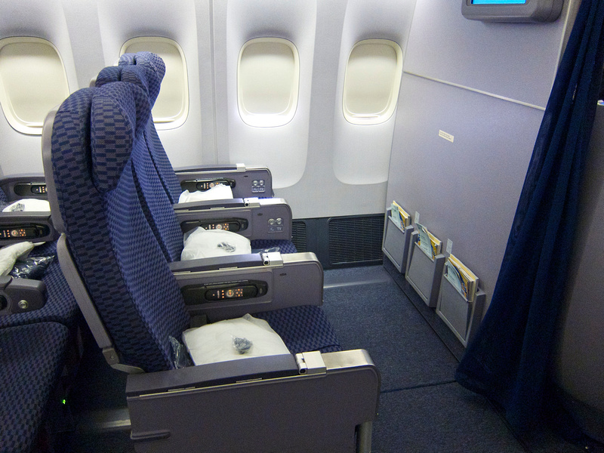
Making Airline Reservations
Talk with Travel agent or make your own reservation by calling the airline directly or making reservations.
Make sure all information is recorded in your computer record
Request bulkhead seat
Direct Flight vs. Connecting Flight
Notes:
The first couple of times that you are booking trips, or if you are unsure of whether or not you would be successful at traveling for the first time, you might want to contact travel agencies that are specifically designed to book trips for individuals with disabilities. There are some that simply know more about disability needs and accessibility issues that would help coordinate the trip, and others that run trips for individuals with disabilities with skilled group leaders and guided tours. These resources are also in the travel packet or can be found on the internet.
Bullet #1- Commentary: Please note that many airlines recommend that customers use the online sites to book tickets so a customer can take advantage of online special fares and some airlines charge a fee to speak to an agent to book a reservation. This does not apply to asking our agents to document reservations to include items and information that cannot be placed in the reservations while online.
Under the second bullet, “Make sure all information is recorded in your computer record” - these are services you will need to make travel accessible for you. You are not required to divulge personal information about your disability.
When making flight arrangements, the reservations agent will be typing your requested information into a computer record. Make sure that everything that you need noted is recorded in that computer record.
**If your flight is cancelled or the flight number is changed, you need to make sure that all of the information in your computer record gets transferred under the new flight number records.
Request A Bulkhead Seat: The bulkhead seat is that first row right after first class. It generally has more leg room between the seat and the wall which could benefit you in several ways:
The extra room could potentially make your transfer easier if you are doing depression or sliding board transfers. It might allow you to get in between the wall and the seat to transfer yourself vs 2 man lift.
The extra room would allow you to perform forward leaning weight shifts during the flight.
On some smaller planes, you will not be able to sit in the bulkhead row because the bulkhead row is oftentimes the emergency exit row. If this is the case, you could ask to be bumped up to first class (although this is not a required action by the airlines) or if there is another aisle seat that has a movable armrest.
Coach vs. Economy Comfort:
Economy comfort seats are the same as normal coach seats, except they have up to 4 inches more of legroom and 50% more recline. These seats generally cost more, but may be preferable to give you more space during the flight.
Direct Flight vs. Connecting Flight: It is always easier to take a direct flight whenever possible. Why?
1. The less movement you need to make, the easier travel will be on you.
2. Having to make a connecting flight increases the risk of your equipment/wheelchair not making it to your final destination if it does not get transferred onto the new flight.
3. Direct flights can minimize the occurrence of delays or missed flights which could limit scheduling conflicts with IC’s, medications, etc.
If taking a connecting flight is your only option:
1. You can request a “Meet and Assist” which will notify the airline personnel to have an employee meet you to assist you in getting to your connecting flight. Please note that any “Meet and Assist” request needs to be documented in your computer file.
2. Ask for your chair to be brought up to the gate of your first flight so you can be assured that it makes it to your connecting flight. If there is a long layover, you definitely want to get back into your everyday chair during that time period. If you must rush from one flight to the other, it is still good to have your chair brought to you so that you know it is not lost!

Slide 7

Important Information to Express to Agent or Airline
Type of device/equipment you use
  Type of wheelchair, battery, etc
  Portable Oxygen Concentrators, ventilators, and regulators
Type of assistance you will need
Type of plane
  Dimensions of cargo area
  Availability of on-board chair
Confirm Boarding/Departing Plan
Transfer/Layover Flights
  Traveler assistance and escorts
Notes:
1. The type of assistive device you utilize (manual chair, power chair, walker, crutches, braces, etc.)
2. The dimensions of your chair (height and width). This will help give you an idea of how your chair will be stored. If you have a larger power chair and are traveling on a smaller plane, your chair may need to be turned on its side to fit in the cargo space.
3. The amount of assistance you will require (for transfers, luggage transport if you are traveling alone, etc.)
4. Oxygen hook-up or vent dependency status- address individually with patient if you have vent dependent person in class
Type of Plane:
Availability of on-board chair: Aisle chairs are not always kept on the flight. Request that one be placed on your flight to enable you to get to the bathroom in the event of an emergency.
Newer Planer: New planes built with more than one aisle are now required to have one accessible bathroom
Transfer Layover Flights:
Reiterate information from previous slide
If possible, allow at least 1-1 ½ hours between connecting flights
Delta: Allows “Wheelchair Assistance” for travelers who need assistance from someone getting to/from gate. These helpers are not actually flying with the person, but will receive a pass to get through security to help the traveler to/from their gate.
*Southwest: Uses the term “Non-Passenger Escort” pass for the same assistance.
*Jetblue: Uses the term “Gate Pass Assistance”

Slide 8
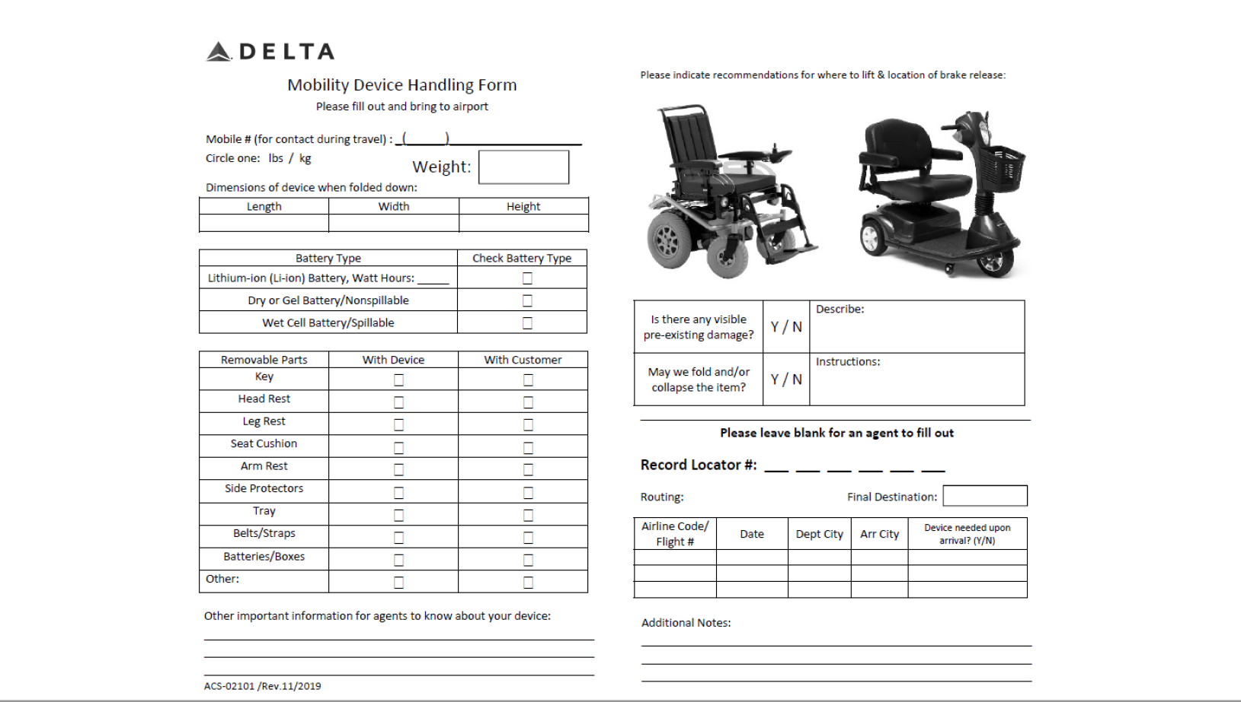
Delta Wheelchair Handling Form

Slide 9

Delta Wheelchair Handling Form
Fill out at least 48 hours prior to check-in
Information on wheelchair used (type, dimensions, battery, brakes, removable parts, ect.)
Traveler’s contact information
Include picture of chair
Notes:
Delta uses a wheelchair handling form as a way to identify your wheelchair and check over it before travel. This helps them identify any damage that may have occurred during travel and prevents it from getting lost.
JetBlue and United Airlines have a similar form called a “Wheelchair Information Card/Form” that they ask you to print and affix to your chair.
Other airlines will most likely have you state similar information over the phone. Make sure they are recording this information in the computer!

Slide 10
Arriving at the Airport
For Domestic flights arrive at least 2 – 2 ½ hours prior to boarding and For International Flights arrive at least 2 ½ - 3 hours in advance of your flight. You must be at the gate 15-30 minutes prior to boarding for domestic flights and 45 minutes prior to the boarding of any international flight.
Check baggage as normal
Do NOT check your chair as baggage. Remain in your chair until you are ready to board.
Confirm seating and transportation/boarding assistance needed. Transfers always occur at the door of the aircraft.
Notes:
Do Not check your chair! This includes both manual and advanced drive (sip and puff; head array) wheelchairs.
*If you use an advanced drive wheelchair and are flying home from Shepherd, consider traveling in a manual back-up chair and shipping your power chair home. This is to prevent your advanced drive wheelchair from damage, as they are more expensive than a manual back-up.
Whatever chair you do decide to travel with, you will need to put a GATE Tag on your chair-not a normal baggage claim ticket. The gate tag will ensure that your chair is brought directly to the gate at your final destination without going through baggage claim.

Slide 11
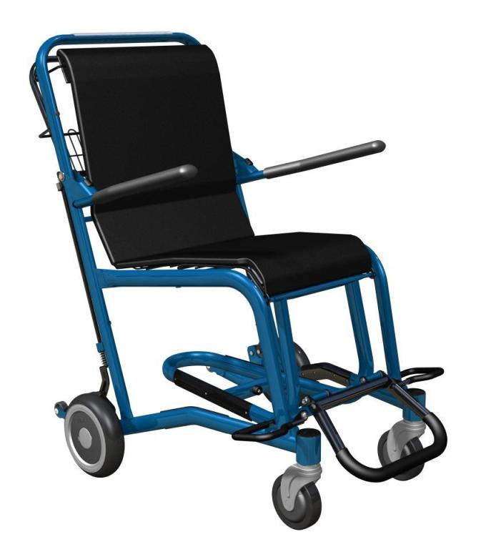

Why Would I Want to Stay in my Own Chair?
Maintaining your level of independence
  Wheelchair propulsion
  Weight shifts
Protecting your skin
Ensuring the safety of your chair
Preparing for unforeseen delays in flight schedules
Notes:
Maintaining your level of independence: Using an airport chair may decrease your independence, especially if you use a power chair. You would have to rely on others to help you with your weight shifts and to push you. Airport chairs are also heavier and bulkier than your everyday chair, making them harder to propel.
Protecting your Skin: Airport chairs do not have the stability and cushioning that your own chair does. This could cause a risk to your skin.
The longer you remain in your chair, the less likely it is for your chair to get misplaced or lost!!
Delays: You never know if your flight is going to be delayed and for how long. You do not want to be forced to stay in an airport chair if this should happen.

Slide 12

Traveling With a Vent
Physician’s statement
Back-up ventilator/additional battery
Ambu Bag
Research type of electricity source at destination
Research equipment vendors at destination
Contact travel agent for vent
hook-up during flight
Notes:
-Must have a physician’s statement identifying it as a medical necessity
-Recommend carrying a back-up ventilator or additional battery in case of an emergency. However, if all else fails, make sure to have your ambu bag.
-Research what kind of electricity source is at your destination prior to flight (volts, amps, watts, ect.) and pack any conversion equipment that you may need.
-Research equipment vendors at your destination in case of an emergency.

Slide 13
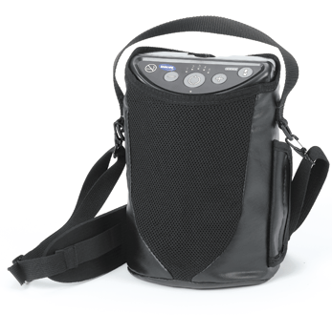
Traveling With Oxygen
FAA approved Portable oxygen concentrator
Physician’s statement
In-flight oxygen sometimes available
Research oxygen suppliers
at your destination
Notes:
-May only use portable oxygen concentrators approved by the FAA
-Must have a physician’s statement identifying it as a medical necessity (include rate of flow/minute)
-Research if airline supplies oxygen (may charge for service). United airlines and Frontier do provide in-flight oxygen in some cities. However, traveler may need to bring own oxygen for use in airport terminals.

Slide 14
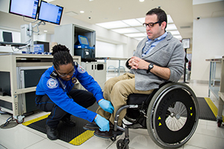
Security Checkpoints
Physician’s letter (not required but available for your convenience)
Check of backpack or carry-on
  Carry-on limit
Manual security check
  Travel companions will go through regular security check
Notes:
Physician’s Letter:You can obtain a letter signed by your physician through your case manager or recreation therapist stating that if a metal detection wand is passed over your body, the alarm may be activated due to rods in your back or metal plates in your neck. **READ COPY OF LETTER
Carry-ons/Backpacks: Your backpack/carry on luggage will either be manually checked or put through the x-ray machine. Different airports may follow different procedures.
**You are not limited to the one bag carry on restriction. Any medical equipment, assistive devices and medications can be carried on to the airplane.
Manual Security Check: You will not go through the overhead screeners. You will enter the security area through a disability access entrance and be manually searched by way of a hand-held metal detector/wand and/or patted down. Your travel companion will have to walk through the overhead screeners and meet you at the other side.
Please Note: If someone is accompanying you to the airport for assistance until you are boarded, but will not be flying with you, please make this aware to the reservations agent when you plan your trip. In addition, when you check in at the airport, the assistant will need to get a “pass” to get through the security checkpoint without a ticket.
Ambu Bag and Portable Suction:
If traveling with an open airway and these supplies, please note that they will still go through security screening. The items will be placed on the security belt, the traveler’s escort will go through security first, retrieve the items, and return them to the traveler immediately after they go through the security pat-down procedure.

Slide 15
TSA Screening
Because many disabilities are not visual, all TSA officers are required to ask any passenger in a wheelchair “are you able to stand, is your party able to assist you with standing or lifting and/or are you able to use upper body strength to lift yourself?” (to check the cushion).
TSA CARES can be contacted about 72 hours before travel at 1-855-787-2227 to have a TSA Passenger Support Specialist escort you through the security checkpoint so TSA can ensure you will be provided with the appropriate level of assistance you need.

Slide 16
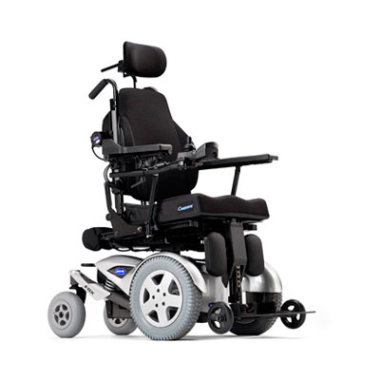
Preparing Your Wheelchair
Remove all removable parts
and place them in a medical
carry-on bag
Remove power assist wheels
and place in the onboard storage location
Have laminated instructions with power chair for how to put it in push mode
Protect power chair’s drive system with a box

Slide 17

Pre-Boarding
GATE Tag your chair.
Tag all removable parts of your
chair or take them on the plane with you.
Take advantage of pre-boarding option
Remain in your chair until you reach the plane door at the end of the jet way.
Prepare to transfer into the aisle chair
Notes:
GATE Tags are different from baggage claim tags on luggage. You want to GATE tag your chair to ensure that your chair is brought to the jetway as soon as the plane lands. Gate tags are usually fluorescent in color (green/yellow/pink). If you had not GATE Tagged your chair when you checked in, be sure to do it now! SHOW GATE TAG
You want to tag all removable parts of your chair in case they become separated from your chair in the cargo area. To increase the safety of your chair, you can try to bungee cord/tape pieces together so the risk of them falling off is minimized. However, it is best that you REMOVE all removable parts off your wheelchair and place them in a carry-on medical bag to prevent them from becoming lost or damaged. This must be done before going through security. As a medical bag this is in addition to your personal carry-on item and it will be allowed to board with you at no extra charge.
Pre-boarding allows you extra time to get transferred onto the aisle chair and then into the airport seat. It will also allow you some privacy so that an entire plane full of passengers isn’t watching you being transferred.
Delta does not provide a preboarding announcement as this draws attention to a customer’s disability. Arrive at the gate prior to the general boarding process beginning ( usually 30 minutes prior to departure) indicate to the gate agent that you would like to preboard the flight. Sit close to the podium in view of the agent.

Slide 18
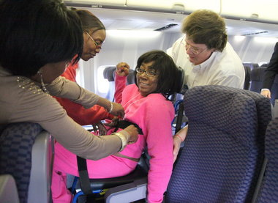
Transferring to an Aisle Chair:
Things to Consider
Training of the airline personnel
  Be assertive! agents are trained to ask you about the best way for you to be transferred. If you are uncomfortable with the transfer, “STOP” the transfer and ask for a CRO.
Support from family member/friend
  You may prefer help from those who better know your needs. Let airline personnel know who you want to help.
Type of aisle chair
  Standard high back chair with only back wheels
  Hydraulic, lower back chair
Notes:
Training of Airline personnel:
Airport security personnel do not have in-depth, specific disability knowledge. They receive brief training during their orientation process, but not extensive everyday practice.
Standard weight limit on most aisle chairs is 400lbs- check with your airline if you have specific concerns.

Slide 19
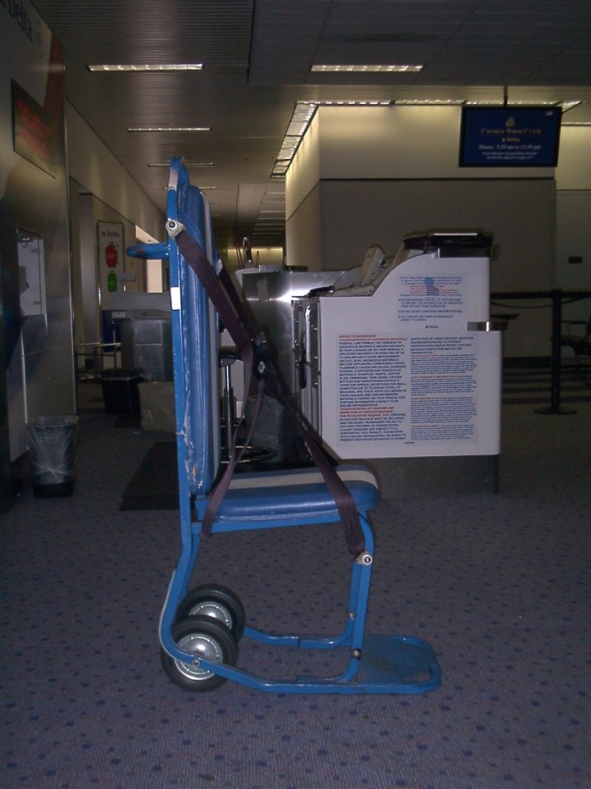
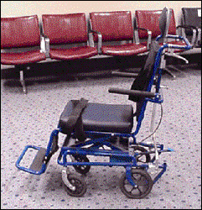
Aisle Chairs
Notes:
Standard High Back Chair:
No front wheels, so you will be tilted back to be moved onto
and off of the plane
Type of chair most airports and airlines are using
Hydraulic, lower back chair:
Piloted by Delta and only available in limited locations
Lower back allows for an easier 2-man lift
The chair raises and lowers to the height of your chair you are
transferring out of and to the height of the airplane seat/armrest
that you need to clear
Front and back wheels allows for easier movement

Slide 20
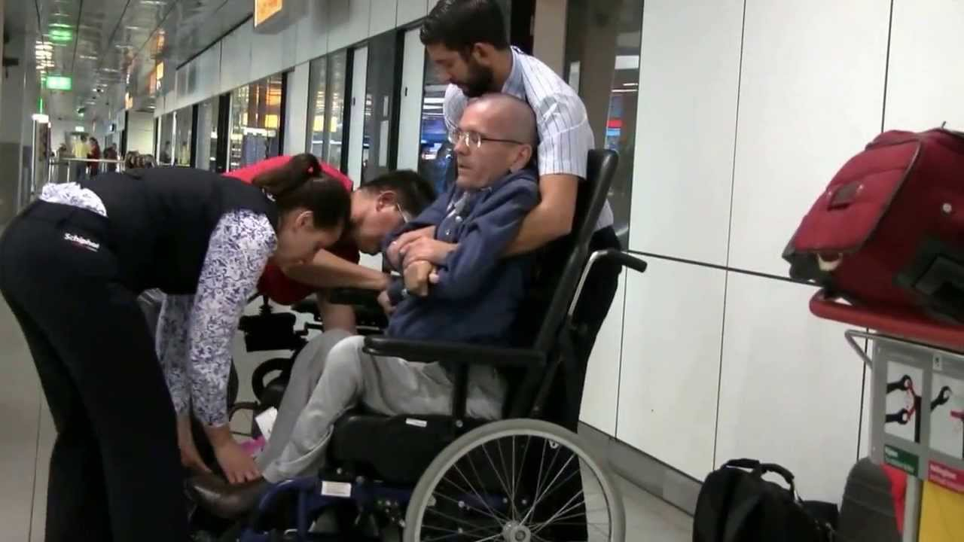
Types of Transfers
Depression/Sliding Board
  May not need hands-on assist
  May just require spotting by airline personnel or family/friend
2-Man Lift (with or without hoyer net)
3-Man Lift (with or without hoyer net)
4-Man Lift (with hoyer net)
Notes:
Review step by step how each transfer should be performed.

Slide 21
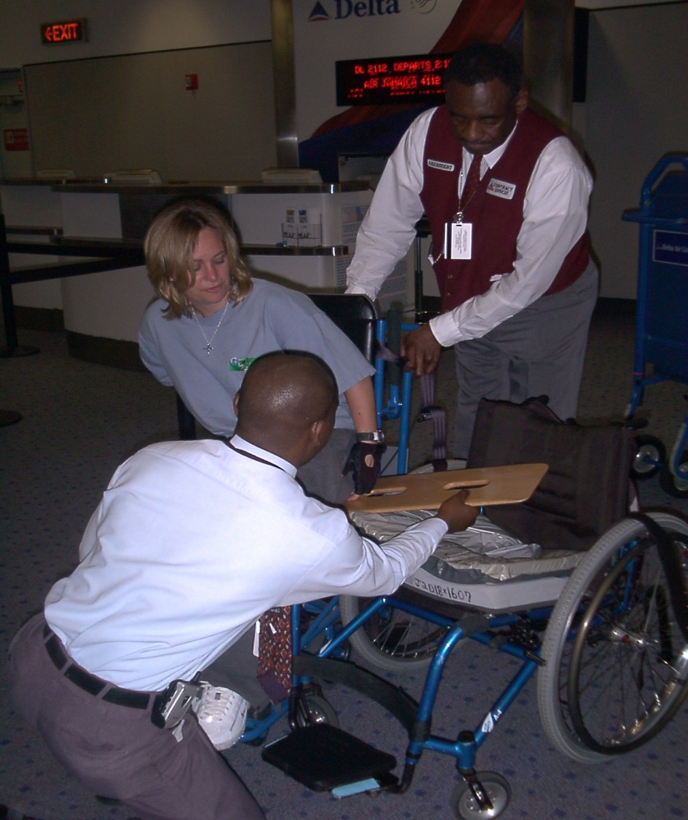
Sliding Board Transfer
Notes:
Advocate how you would like your transfer to be done. Airline employees are there to help, but you have to be specific and tell them how to. Tell them what they should do in order to best help you transfer into the aisle chair and plane seat.

Slide 22
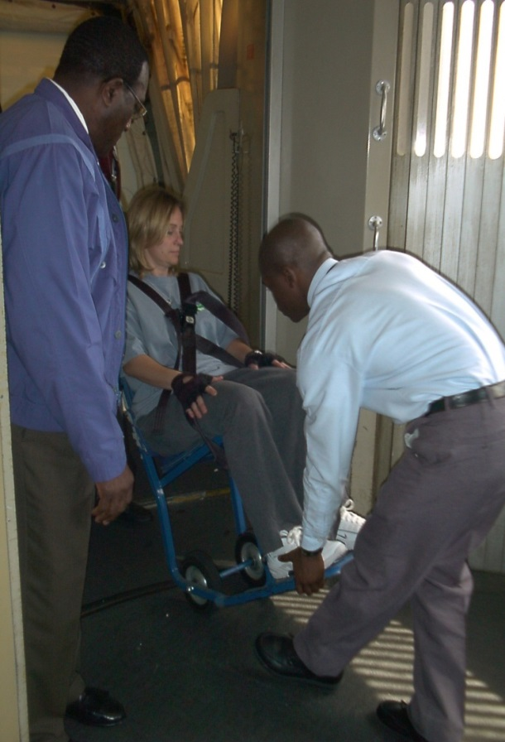
Ready to Board
With transfer to aisle chair complete, make sure airline staff secure you with safety straps onto the chair
Remove cushion from your chair to bring on plane with you.
  Air cushion vs. Gel cushion
Notes:
Air Cushion Vs. Gel Cushion
If you have an air cushion, you may need to let a little bit of air out of the cushion. As you increase in altitude, the air in your cushion may expand, causing it to increase in firmness. This normally occurs in longer flights that achieve greater altitude.

Slide 23
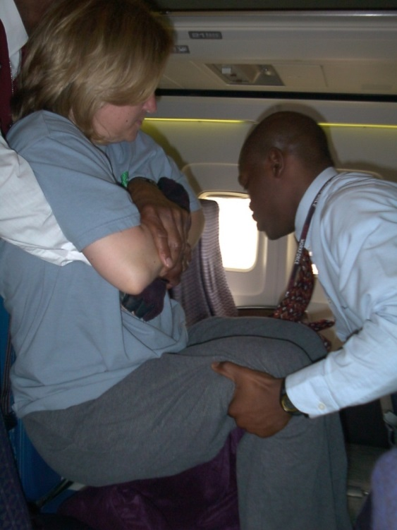
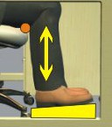
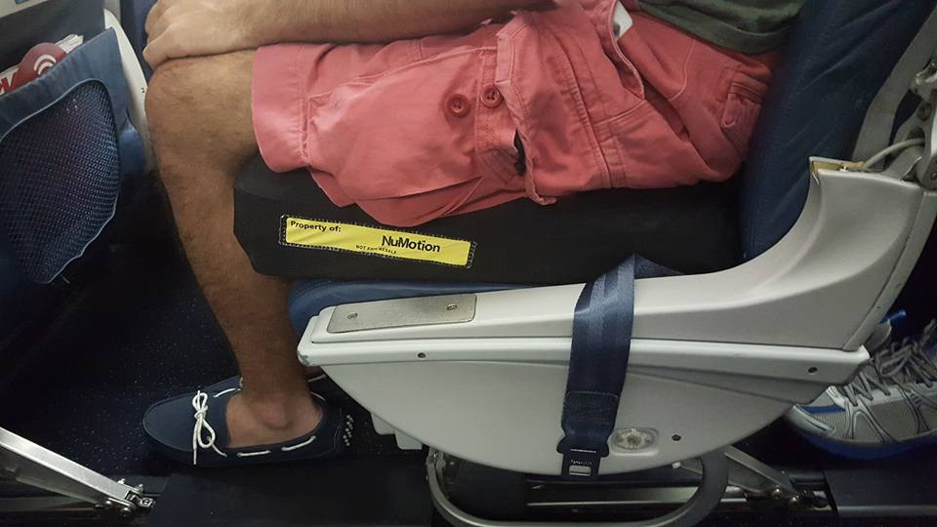
Transferring to Plane Seat
Place your cushion on the airplane seat.
If the armrest of the seat is movable, raise the armrest.
If the armrest does not raise, place a blanket over the armrest to protect your skin.
Put seatbelt on immediately.
Make sure legs are supported at 90⁰ angle
Notes:
Do not use pillow because it can move/fall off too easily-only use as last resort.
Support legs at 90 degrees. Your feet should not be dangling. If your feet do not sit on the ground, you run the risk of cutting off circulation. Problem solve ways to support your feet/legs.
Please note: Crewmembers will ask you to remove any objects placed under your feet to support your legs during take off/landing, especially in bulkhead seats. In these cases, the traveler may ask for the flight attendant to assist them in placing the items under their feet during flight.

Slide 24
Tips for on board the airplane:
Sit on wheelchair cushion in the airplane
  Air vs gel cushion
Take something along if you will need it to put under your feet so your knees are at a 90° angle
Chest strap or Body Bracer
Know how you will do your weight shifts
Notes:
If using something to help prop your feet up, you may be asked to remove it during take off and landing 2’ FAA regulations, however the flight crew can help you position once permissible during the flight if needed

Slide 25
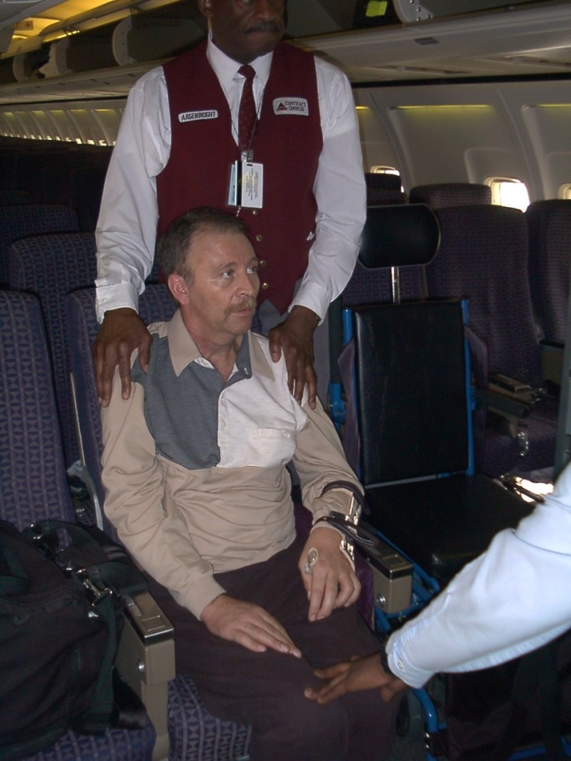
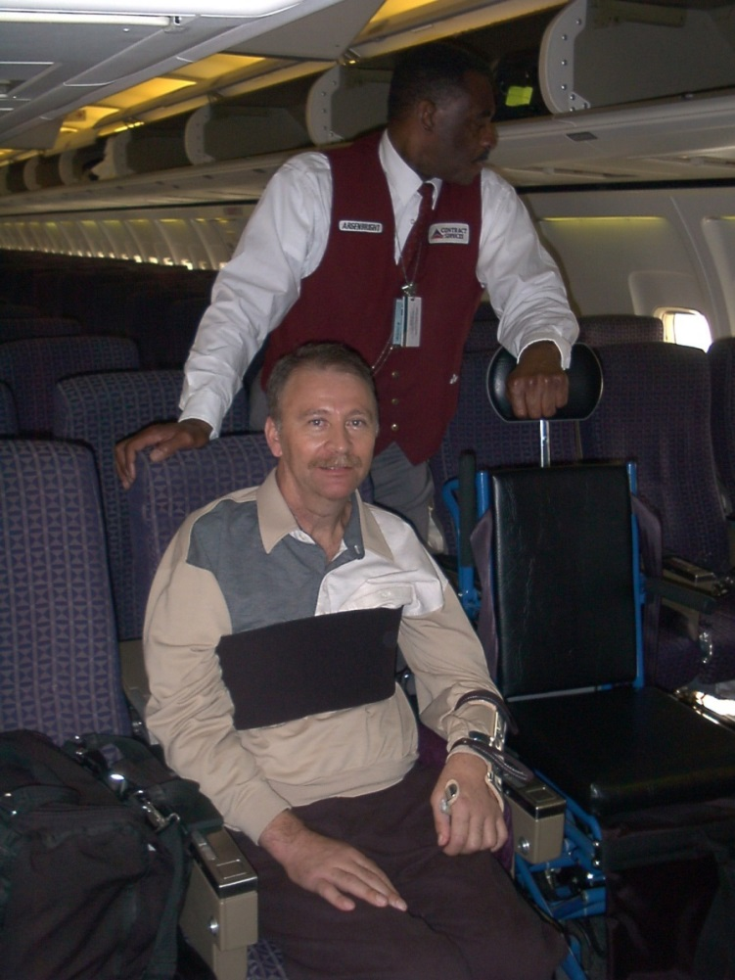
Balance & Positioning
Notes:
If you have limited or no trunk control, you might want to consider bringing an additional safety belt for your upper trunk.
In the current slide, the individual has used a Neoprene chest strap to ensure his safety during take-off, if turbulence should arise, and during landing.
Please note: If you are using an additional strap, please remember to put down the tray on the seat behind you prior to securing the strap. Once the strap is secure, restow the tray. This will ensure that the person sitting behind you can still utilize their tray.
DEMONSTRATE IF AIRPLANE SEATS ARE IN THE ROOM.

Slide 26

During the Flight
Obtain the name of one of the flight attendants.
Flight attendants are not required to help you with any personal needs, i.e., feeding, medication management, IC’s, etc.
Prior to arrival, remind the
flight attendant that your
chair needs to be brought
back to the jet way.
Notes:
Obtain the name of one of the flight attendants: This will ensure Accountability.
If you remind the flight attendant that s/he is responsible for making sure you are safely transferred off of the plane upon arrival, s/he may be more conscientious if s/he knows you have his/her name. You want to do all you can to prevent the flight crew from exiting the plan in a rush to catch their next flight, and you remaining on the plane waiting to be transferred.
Personal Needs: Although flight attendants are not required to help with personal needs, they can assist you in some ways. For example, if your feeding equipment is in the overhead bin, they can get it for you. If you have to do an IC and the bathroom is not accessible, then can hang a privacy curtain for you.
Flight attendants can radio ahead to your destination to make sure your wheelchair is brought to you upon the plane’s landing. It will be brought directly to the door of the plane, where you can be transferred from the aisle chair directly to your own chair.

Slide 27
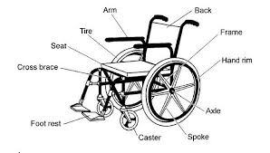
Getting Ready to Land
Talk with Flight Attendant
  Accountability
Departing Plane
  You will be preboarded first for your convenience and deplaned last for your safety. – Sit Back & Relax
Inspect your Device/Equipment immediately!
  Do not leave the airport without talking to a CRO, especially if there is damage to your wheelchair or assistive device.
Notes:
Inspect your device/equipment immediately: Make sure nothing is damaged, that all pieces are attached and working properly. If something is wrong with your equipment, do not leave the airport until you speak with a Complaint Resolutions Officer and file a report.

Slide 28
What do I do if I have a Complaint???
Complete an inspection
Document immediately
Speak to CRO - Complaint Resolution Official
File a claim for follow up.
Record names from flight personnel to general airport personnel
Keep all receipts, tickets, dates, and times
Call the DOT Hotline if you do not get the resolution to protect your right or restore your equipment to the same condition as it was presented for travel.” 1-800-778-4838 (voice) or 1-800-455-9880 (TTY).
Notes:
Refer to information summary.
Also, the Department of Transportation developed a new aviation consumer disability hotline effective August 2002. The main purpose of the hotline is for consumers to be able to voice complaints and concerns with respect to a disability related air-service problem
Complaint Resolution Officials (CRO’s):
Complaint Resolution Officials specialize in helping people with disabilities with air travel. If you feel that your rights are being discriminated against while flying, ask for a CRO. These individuals will help intervene to make sure your rights are protected.

Slide 29

Travel Resources
Resource Packet from TR
Internet
Organizations (United Spinal Association’s
AbleThrive)
Summaries of the laws protecting your rights
Magazines/Publications (Accessible Journeys)
Travel Agencies
Airline websites and brochures about customers with disabilities.
http://www.delta.com/traveling_checkin/travel_tips/disabilities/disability.jsp
Notes:
Best starting point for getting back into travel is the resource packet from your therapeutic recreation specialist. This packet takes you through all of the information we just covered, plus information on transportation at your destination, pointers for hotel rooms, etc. In addition, it will give you a list of some of the better travel websites, information on the law, travel agencies, etc.
(SHOW RESOURCE PACKET)

