Slide 1
Emergency Preparedness
For people with mobility impairments

Slide 2
FACTS
“people with mobility impairments represent a segment of the population with one of the highest risks of dying in a fire.”
-Federal Emergency Management Agency (FEMA)
“According to incident reports filed by local fire departments, physical disability was a factor in an average of 380, or 14%, of home fire deaths per year between 2004 and 2008.”
-National Fire Protection Association Fire Analysis and Research Division

Slide 3
FACTS
“One of the things learned from the response to Hurricane Katrina was that people with disabilities were disproportionately affected by the storm and its aftermath.”
- Centers for Disease Control and Prevention (CDC)
In 2005 the National Council on Disability reported that:
“Only 47% of people with disabilities had developed plans to evacuate their homes in the event of a disaster and only 54% knew whom to contact about emergency plans in their community”

Slide 4
The Purpose
To help you and your caregivers start thinking about how to be prepared for emergencies when you return home.
We will be covering:
Fire safety at home/work/school
Natural disasters
Notes:
Even if your mobility impairment is not expected to be a permanent issue, most people continue to have some level of difficulty with mobility after they return home from Shepherd Center. It’s important that you and your caregivers take your current level of mobility impairment into consideration while thinking about emergency preparedness at home.

Slide 5
The keys to successful responses for most emergencies are similar:
Knowing there is an emergency quickly
Having a thorough, well practiced plan to respond to the emergency
Having the resources needed to respond on hand ahead of time

Slide 6
Fire Safety
Everything you learned in elementary school, plus a bit more!

Slide 7
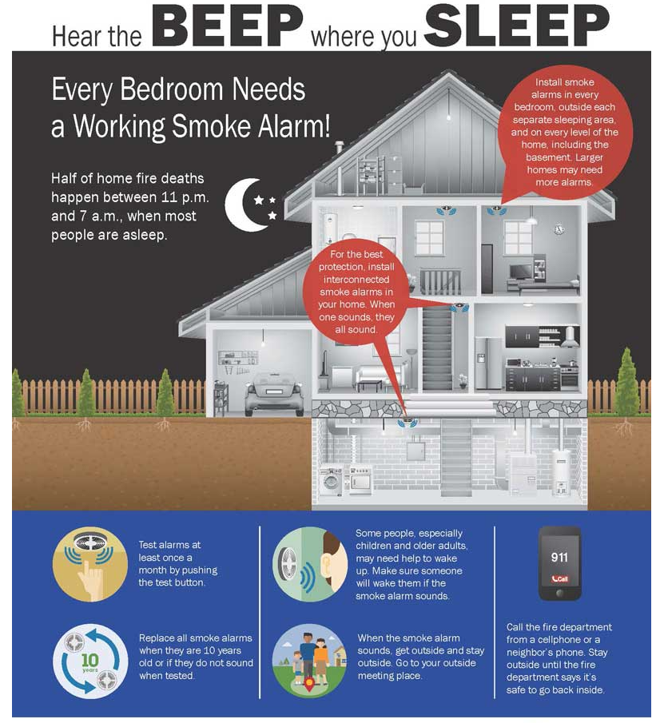
How will you know there’s a fire?
Smoke Alarms:
The sooner you know, the more time you have to react
Where?
Every bedroom, outside sleeping areas, and on every level
Alarms should be interconnected
Detailed information about smoke alarms can be found at:
www.usfa.fema.gov
www.nfpa.org
Notes:
It may take a little longer to get out of your home in the event of a fire if you have a mobility impairment, especially if you need help transferring from your bed or a couch back to your wheelchair or if you use a walker or other assistive device.
Number of alarms needed
Type of alarms needed
How to install (according to manufacturer’s directions)
Where to install
Testing and maintenance
What types of smoke alarms can I buy?
-There are many brands of smoke alarms on the market, but they fall under two basic types: ionization and photoelectric.Ionization and photoelectric smoke alarms detect different types of fires. Since no one can predict what type of fire might start in their home, the USFA recommends that every home and place where people sleep have: Both ionization AND photoelectric smoke alarms.
OR
Dual sensor smoke alarms, which contain both ionization and photoelectric smoke sensors.
Choose interconnected smoke alarms, so when one sounds, they all sound.There are also alarms for people with hearing loss. These alarms may have strobe lights that flash and/or vibrate to alert those who are unable to hear standard smoke alarms when they sound.
Are the expensive?
Smoke alarms are not expensive and are worth the lives they can help save. Alarm type and cost Ionization and photoelectric: $6 and up
Dual sensor: $24 and up
Smoke alarms with a microprocessor (faster to alert, fewer false alarms): $30 and up
Radio frequency/wireless (communicate from one to the next without wires): $40 and up
Your city, county or state may require a specific type of alarm. Please check with your local fire marshal for information on what type of alarm you need.Some fire departments offer reduced-price, or even free, smoke alarms. Contact your local fire department's non-emergency phone number for more information.
Where do I put smoke alarms in my home?
A closed door may slow the spread of smoke, heat and fire. Put smoke alarms inside and outside each bedroom and sleeping area. Put alarms on every level of the home. Smoke alarms should be interconnected. When one sounds, they all sound.
Place smoke alarms on the ceiling or high on the wall. Check the manufacturer's instructions for the best place for your alarm.
Only qualified electricians should install hardwired smoke alarms.
Some fire departments will install battery-operated smoke alarms in your home at no cost. Contact your local fire department’s non-emergency phone number for more information.

Slide 8
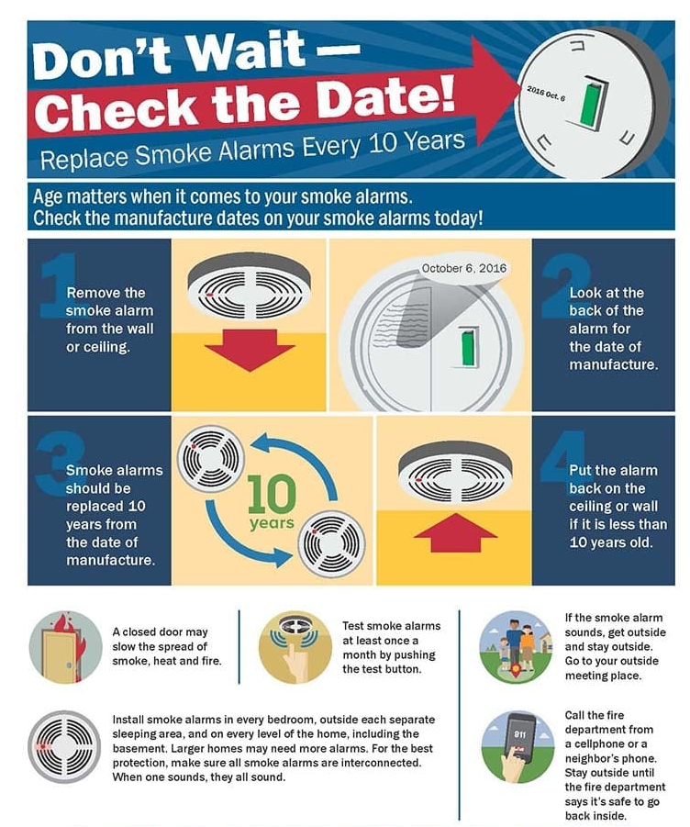
Smoke Alarms:
Test your alarm monthly
Replace them every 10 years:
Technology upgrades
Replace the batteries at least once a year
Your local fire department will:
Be happy to come to your home and help you install smoke detectors correctly
Change out the batteries for you if you ask them!

Slide 9
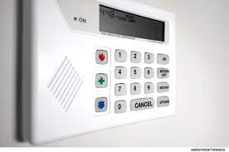
How will you get help?
Keep an accessible phone handy
Consider a monitored home fire alarm system
Make your address easily visible from the street
Notes:
Phone handy at all times, even at night, phone could be sip n puff or cell under pillow
This way the fire department will be alerted immediately – you can start working on evacuating immediately
Address visible so that first responders can find you easily and quickly. Time is valuable!
*House numbers that are contrast (black and white) and non-decorative/script numbers.

Slide 10
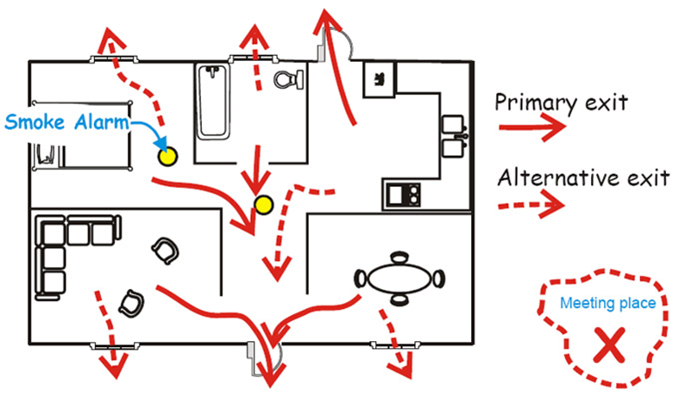
How will you get out?
Plan detailed escape plans for home and for work/school and practice them!
Practice your evacuation plans with all the people who agree to assist you – make sure everyone feels comfortable with their training!
Make sure to give copies of your evacuation plans to the security personnel at your work or school
www.nfpa.org/disabilities
Notes:
Make sure to practice/simulate during the day and night.
Re-visit evacuation/fire safety plan every year or if those living at home change (or hire new caregivers).

Slide 11
Sample questions from Personal Emergency Evacuation Planning Checklist found at www.nfpa.org/disabilities:
TYPE OF ASSISTANCE NEEDED:
Can the person evacuate himself or herself with a device or aid?
What is the specific device or aid?
Where is the device or aid located?
Does the person need assistance to evacuate?
What does the assistant(s) need to do?
Does the assistant(s) need any training?
Has the training been completed?
Where will the assistant(s) meet the person requiring assistance?
When will the person requiring assistance contact the assistant(s)?
Notes:
The Emergency Evacuation Planning Checklist available through the National Fire Protection Association is very thorough, and can help ensure that an emergency evacuation plan is addressing all the necessary topics.

Slide 12
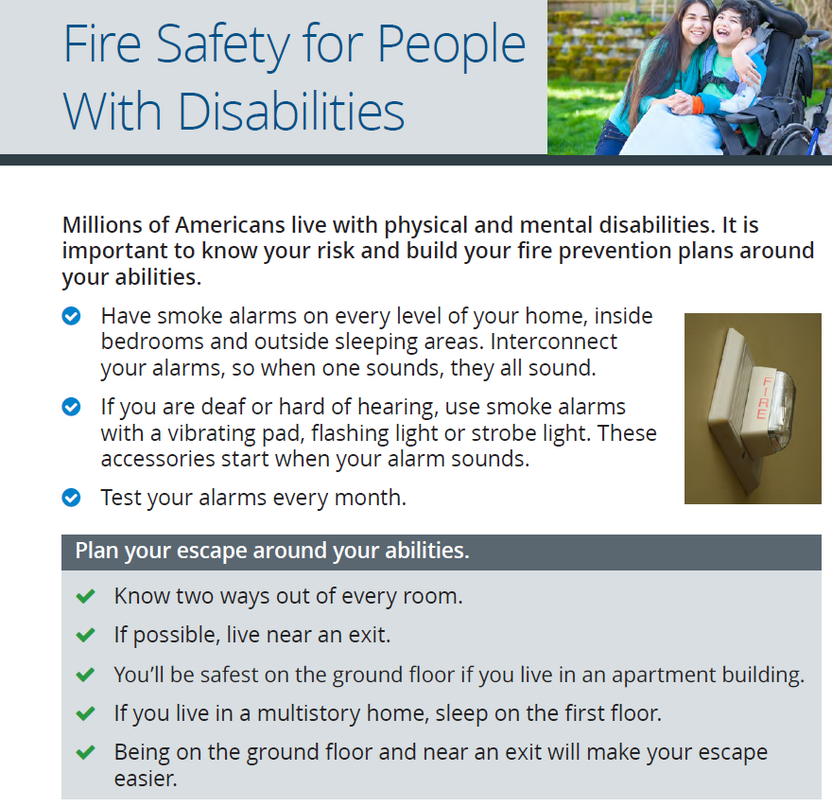
In Your Home
Be sure you have at least two accessible exits
Consider ability to open door
Keep your wheelchair within reach when you’re in bed or on the couch/recliner
Consider sleeping in the most accessible room
Have a fire extinguisher available
Sprinkler systems and compartmentation walls are an option
Notes:
That includes ramps, as well as being able to unlock and open the door without help!
If your chair isn’t within reach you’ll either need help, or getting out will take a good bit longer!
A ground-level room with access to the outside is an ideal situation. If French doors are available, a caregiver could roll your bed outside easily to get you out of danger
The first step is to look at what materials are present in the area to be protected from fire. These can be divided into six categories of fire involving different substances:
Class A, combustible carbon-based solids eg paper, wood or textiles
Class B, flammable liquids eg paraffin, petrol, diesel or oil (but not cooking oil)
Class C, flammable gases, eg butane, propane or methane
Class D, burning metals, eg aluminium, lithium or magnesium
Fires caused by electrical equipment (indicated by an electric spark symbol and not the letter E)
Class F, fats and cooking oils.
The prices of all extinguishers vary widely according to supplier, so purchasers are advised to shop around. The future cost of servicing will also need to be taken into consideration. Some firms charge for installation and commissioning, but they should be supplied with a 5-year warranty and mounting brackets included. Approximate prices given below include VAT.
Five main types of fire extinguishers
Water, water mist or water spray
Foam
Dry Powder – standard or specialist
Carbon Dioxide (‘CO2’)
Wet Chemical
Which fire extinguisher types to use
Class A fires – water, water mist, foam, dry powder, wet chemical
Class B – water mist, foam, dry powder, CO2, some wet chemical
Class C – water mist, dry powder
Class D – specialist dry powder
Electrical – water mist, foam, CO2
Class F – water mist, wet chemical.

Slide 13
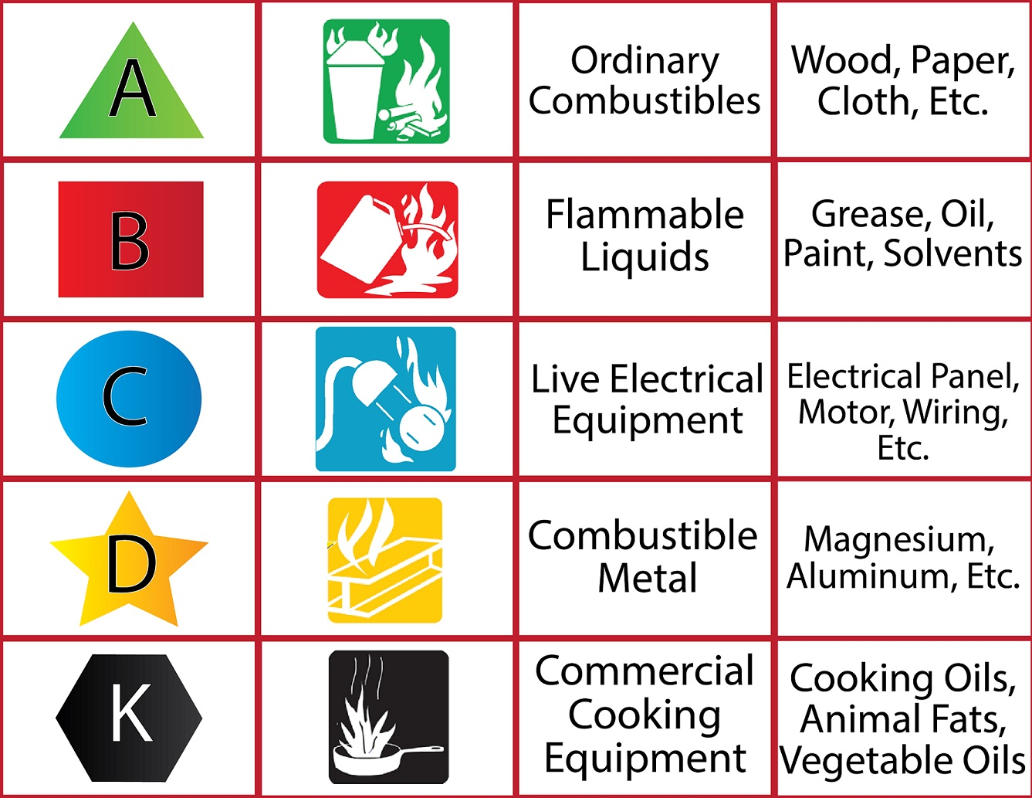
Fire Extinguishers:
Five main types of fire extinguishers
Important to know so you have the desired one in areas of your home
Purchase fire extinguishers with an ABC rating (multipurpose) for home use
Should be replaced every 10-12 years
Notes:
The first step is to look at what materials are present in the area to be protected from fire. These can be divided into six categories of fire involving different substances:
Class A, combustible carbon-based solids eg paper, wood or textiles
Class B, flammable liquids eg paraffin, petrol, diesel or oil (but not cooking oil)
Class C, flammable gases, eg butane, propane or methane
Class D, burning metals, eg aluminium, lithium or magnesium
Fires caused by electrical equipment (indicated by an electric spark symbol and not the letter E)
Class F, fats and cooking oils.
The prices of all extinguishers vary widely according to supplier, so purchasers are advised to shop around. The future cost of servicing will also need to be taken into consideration. Some firms charge for installation and commissioning, but they should be supplied with a 5-year warranty and mounting brackets included. Approximate prices given below include VAT.
Five main types of fire extinguishers
Water, water mist or water spray
Foam
Dry Powder – standard or specialist
Carbon Dioxide (‘CO2’)
Wet Chemical
Which fire extinguisher types to use
Class A fires – water, water mist, foam, dry powder, wet chemical
Class B – water mist, foam, dry powder, CO2, some wet chemical
Class C – water mist, dry powder
Class D – specialist dry powder
Electrical – water mist, foam, CO2
Class F – water mist, wet chemical.

Slide 14
In Your Home:
Keep at least a few days worth of your medications together so you (or a first responder) can grab them quickly when you evacuate.
If you use a power chair, be able to verbalize how to put your chair into manual mode
You may want to put brightly colored tape on the “brakes” to make it easier to explain
Notes:
This could buy you some time to call your pharmacist and get medications replaced. It’s especially important if you take medications that could make you sick if you stop taking them abruptly. Baclofen is a good example of one of those medications!
You and the other survivors are the first priority, but first responders may be able to go back in for your power chair if it’s safe enough for them to do. You may even want to have pictures that help you explain how to put your chair into manual mode!

Slide 15
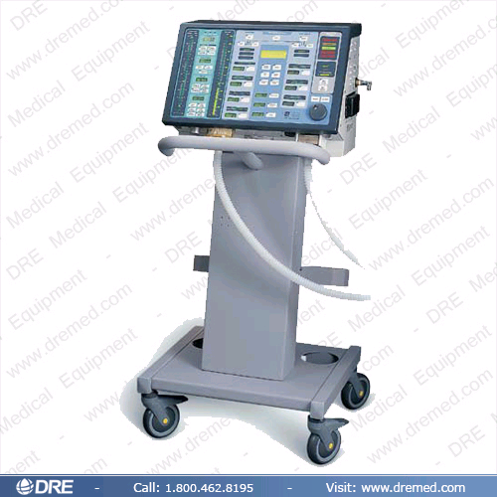
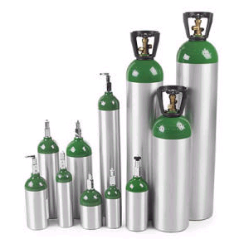
Oxygen and ventilators

Slide 16
Oxygen
Flammable vs accelerator
Risks
Smoking, flames from matches, candles, or furnaces
Hot elements in space heaters or hair dryers
Electric arc produced when plugging in the television
Oxygen tanks used improperly
Steps to reduce risks
No smoking
Utilize the 5-foot rule (always 5 feet away)
Don’t use products that can easily burn (i.e., cosmetics, waxes, greases, etc.)
Store oxygen containers properly (upright)
Keep a fire extinguisher nearby
Notes:
O2 is an accelerant. If there is a fire and O2 is present, then the fire will burn faster and hotter.

Slide 17
Vents
ALWAYS have your ambu bag
Limited internal ventilator battery life
Contact your local utility companies and first responders to let them know you have sensitive medical equipment in use at your home.
If you need to get out quickly, hyperventilate (3-5 breaths) then continue to bag once you are outside.
EMS will have means to ventilate once they arrive.

Slide 18
If you can’t get out and must wait for first responders:
In public buildings, get yourself into the closest stairwell
Withstand a fire longer than other areas of the building
Path the fire fighters are taking to access the building
Worst-case scenario:
If all other options are out, consider trying to throw yourself to the floor from your bed or wheelchair
Notes:
Even if you can’t use the stairs, stairwells in public buildings are built to withstand fire longer than other areas of the building. It’s also one of the first places first responders check for survivors.
Smoke rises, and the best air for breathing will be at floor-level.

Slide 19
RESCUE Program
RESCUE is a comprehensive program designed to provide education to individuals with disabilities about emergency preparedness, to provide education to emergency responders about disability, and to facilitate pre-emergency communication between community members and emergency responders.
Notes:
This is a picture of the actual sticker that is given in the RESCUE packet
The sticker is reflective, and is designed to be placed in the front window of your home. If you don’t live in the Metro-Atlanta area, it will mean nothing to the first responders. But the purpose of the packet is to get the you to contact your Fire Department, who will enter information about your special needs into a database that will be accessed when 911 is called. Information could include what room you sleep in in your home, what your specific disability is, medications that might be necessary to grab if possible, etc.
It was noted that stickers were common for “save my pet” or “save my toddler”, but nothing was widely available in the Atlanta area for alerting first responders to the presence of people with disabilities in the community.

Slide 20
Will the sticker increase crime?
There is currently no research to support an increase in crime with use of the sticker!
Stickers known to decrease home invasions:
Alarm signs and decals
Dog signs
Neighborhood alert signs
Stickers/circumstances known to increase home invasions:
Weapons on property signs
Known drug dealer
Value of car in driveway
Notes:
A lot of thought and research was put into finding out whether having a sticker could increase the liklihood of a home invasion. There is currently no research to support the idea of an increase in crime in the presence of a sticker indicating that someone in the home has a disability.
Read the bullets on the slide
For our patients who are concerned about it, it definitely isn’t necessary that the sticker go in the window. It’s still important to take the packet, because the point is for the community member to contact their fire department.

Slide 21
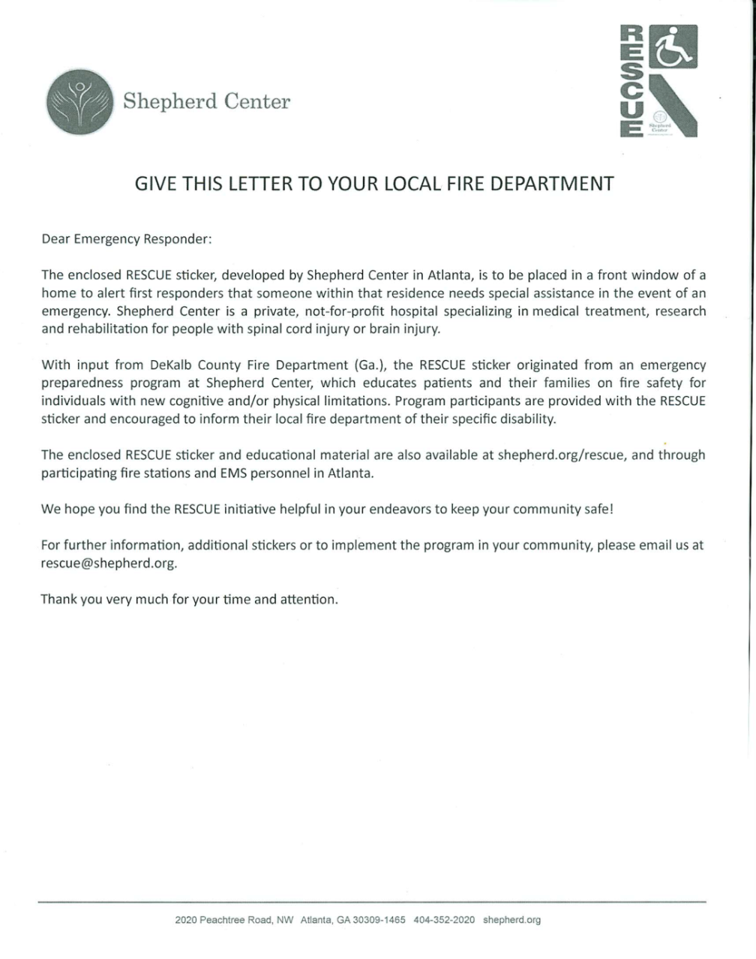
Rescue Packet
Notes:
This is a copy of the letter that is in the RESCUE packet. It describes the purpose of the RESCUE program, and is designed to be taken to the individual’s local fire department and initiate the communication between the community member and first responders.

Slide 22
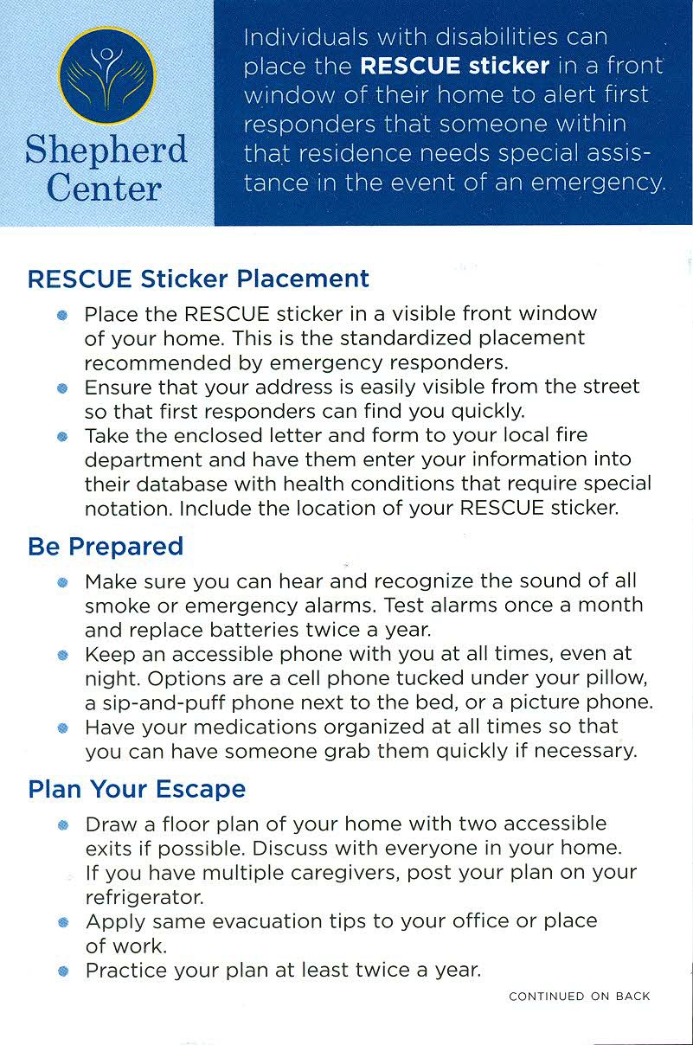
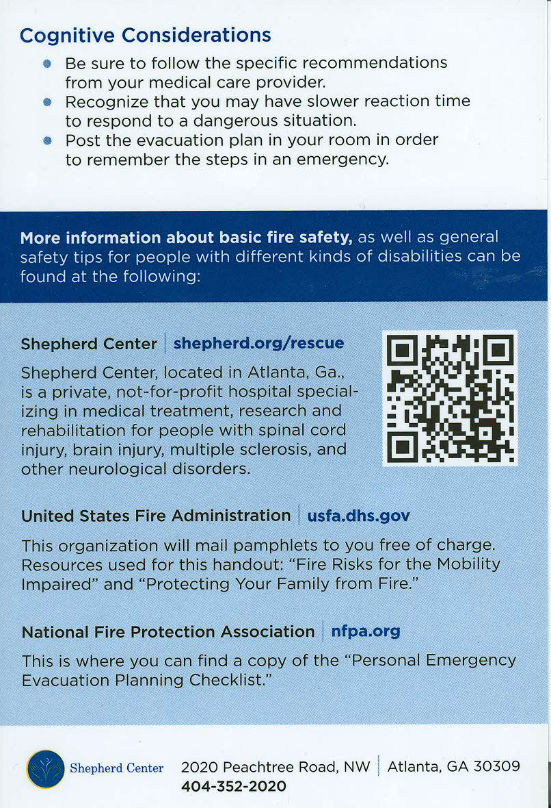
Notes:
This is the front and the back of the companion card that is included in the packet. It explains the RESCUE sticker placement, and outlines the very basics of the information covered in the Fire Safety class since not everyone who gets a packet will have attended the class. It also offers resources for getting more information about emergency preparedness.

Slide 23
When to visit the fire department? Why?
Recommend that you visit your local fire department 3 days in a row
Explain your physical capabilities and limitations
Give them a copy of your escape plan and ask if they have any suggestions
Make sure they know which room you sleep in in your home
Teach them about your chair and educate them on anything else they need to know about you
Ask them if they have any questions for you!
Notes:
This way you’ll be sure to meet all the firefighters, regardless of which shift they work

Slide 24
Carries and Evacuations
Always
Keep open communication between yourself and your helpers
Make sure your helpers are using proper body mechanics

Slide 25
Proper Body Mechanics
Keep your hips under your shoulders
Use your gluts and quads to lift, not your back or arms (bend with your legs, not with your back)
Keep the object close to your center of mass (COM)
COM is close to your belly button
Don’t twist, keep your feet & hips turned in direction that you are moving, or shift weight from one leg to another
Adjust the height of the bed or put one knee on the bed to allow you to get closer to the patient and keep your hips under your shoulders.

Slide 26
Two Person Hold/Carry

Slide 27
Two Person Lift/Carry
Performed by two people
Strongest helper lifts the trunk
Other helper scoops the legs from the side
Best if head/neck control is present
The person being lifted bears down with shoulders

Slide 28
Sheet over Toes Carry
Bring knees to chest, fold sheet over toes and knees. Criss cross sheet and tuck ends behind knees
At least two helpers
Can provide good support to head and neck if necessary and person is not too tall.

Slide 29
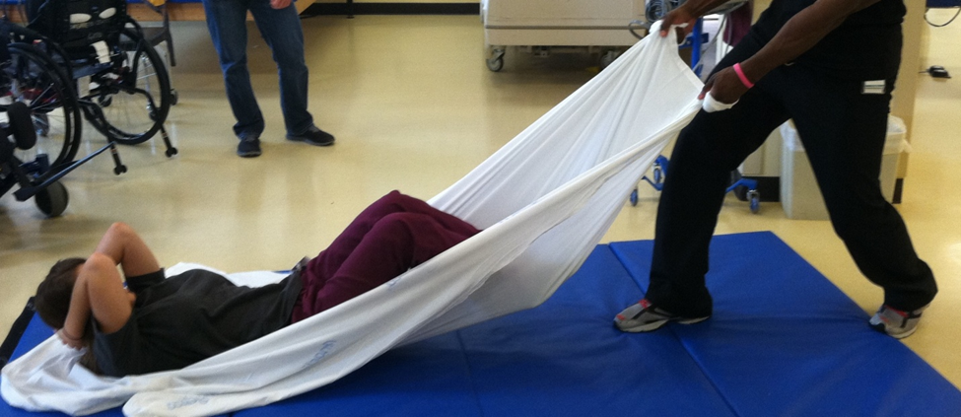
Sheet Drag
Least desirable due to risk of skin shearing
Can be done with one helper
If no sheet is available, it will be best to drag the person out by their legs instead of arms

Slide 30
Getting someone out of bed with one caregiver
Be sure to lower the bedrails first and lower the bed as much as possible
Could possibly turn the mattress sideways and have it act as a slide to lower the person to the floor
Swing the legs off the side of the bed first and then lower torso and head to the floor
Grab sheet (or use two-man hold)and lower to the floor

Slide 31
Getting someone out of bed with one caregiver

Slide 32
Getting someone out of a power chair with one caregiver
Remove chest strap and seat belt
Flip up foot plate
Raise one of the armrests
Lower person to the floor with the two-person hold

Slide 33
Natural Disaster Preparedness
Natural disasters often occur quickly and without much warning. The key is to be prepared for them ahead of time!

Slide 34
Natural Disasters: Which are common in your area?
Air Quality
Droughts
Earthquakes
Floods
Flus and outbreaks
Hurricanes
Lightning
Rain and snow
Security
Tornadoes
Tsunamis
Wildfires
You can get information from your state and local Emergency Management Agency (EMA) or Homeland Security Office by visiting their Websites.
Notes:
You may be able to talk with your home/renter’s insurance company to find out what natural disasters are most common in your area.
Do you have an accessible place in your home to go in the event of a tornado?
Know what natural disasters are common in your area and when they typically strike

Slide 35
Keep yourself informed
Wireless emergency alerts (WEA)
Emergency Alert System (EAS)
NOAA weather radio
Real-time hazard maps
www.nesec.org - Northeast States Emergency Consortium
http://nhss.cr.usgs.gov – Natural Hazards Support System
http://naturalhazardmapping.com/hazard_maps/interactive
Notes:
Wireless Emergency Alerts (WEA) send free informational text messages to WEA-enabled cell phones within range of an imminent and dangerous local situation, severe weather event, or AMBER emergency.
You do not need to register to receive WEA notifications. You will automatically receive alerts if you have WEA-capable phone and your wireless carrier participates in the program.
To find out if your mobile device is capable of receiving WEA alerts, contact your mobile device carrier or visit CTIA The Wireless Association.
The Emergency Alert System (EAS) can address the entire nation on very short notice in case of a grave threat or national emergency. Ask if your local radio and TV stations participate in EAS.
National Oceanic and Atmospheric Administration (NOAA) Weather Radio (NWR) is a nationwide network of radio stations broadcasting continuous weather information directly from a nearby National Weather Service office to specially configured NOAA weather radio receivers. Determine if NOAA Weather Radio is available where you live. If so, consider purchasing a NOAA weather radio receiver.
These are just some examples of hazard maps that we found online. They may not be the best or most reliable!
The Red Cross has several smart phone apps available that can help keep you informed of tornadoes, hurricanes, earthquakes, and shelters available in your area.
Ready Georgia also has a free smart-phone app with lots of good information

Slide 36
During and following a natural disaster, your whole community may be affected:
When you get home from Shepherd, register with the Emergency Management Agency (EMA) in your county.
When there is a community disaster, the American Red Cross contacts the EMA in that county to find out who needs help evacuating their homes
The Red Cross then will provide transportation to local shelters for individuals registered with that county’s EMA

Slide 37
Shelters
Equipment people are allowed to take to a shelter is limited due to space limitations. If you are allowed only one piece of equipment at the shelter, your wheelchair cushion may be a good option.
When you register with the EMA, make it clear that you are dependent for mobility without your wheelchair. This may increase your chances of getting to keep your wheelchair with you at the shelter.
In the event of a community disaster requiring evacuation, accessible shelters can be found at www.redcross.org or on the Red Cross Shelter smart phone app

Slide 38
Emergency Evacuation Considerations:
If you are using your own transportation to go to a shelter or to get out of town:
Make sure you have enough gas in your vehicle
Gas stations along an evacuation route may run out of gas
Stations may be closed in an emergency
Power outages may affect ability to pump or buy gas
Always keep at least ½ of tank in your vehicle
Map out a route and/or alternative routes
Have cash available
Notify family and friends of your plans

Slide 39
Things to consider during a natural disaster:
During and following a natural disaster, you may not have power, water, phone, or cable service. Over the course of a couple of days this could affect your:
Bowel and bladder care
Medical equipment needs
Ventilator
Oxygen
Power Wheelchair needs
Communication with others
Cell phones
Home phones
Internet Access
Medication refills and medical supplies

Slide 40
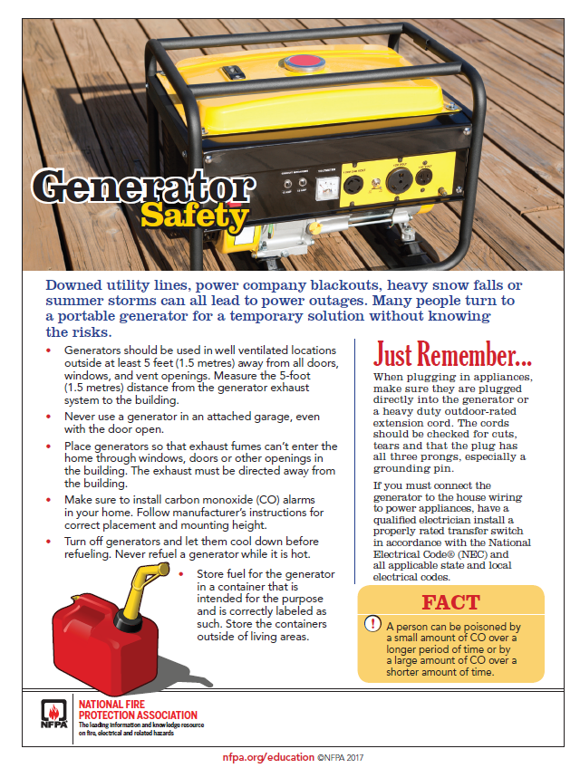
You can prepare by doing the following ahead of time:
Make your local utilities companies are aware of your medical needs ahead of time – they will likely put you on a list to have your services restored more quickly
Keep enough non-perishable food on hand for everyone in your home for about three days, as well as a manual can opener
Consider purchasing a back-up generator for your medical equipment

Slide 41
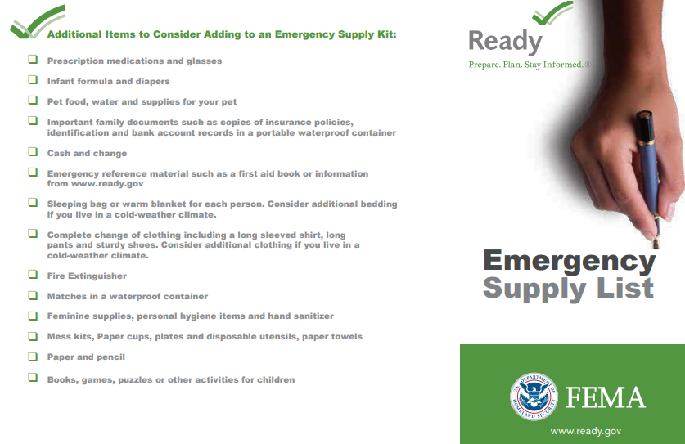
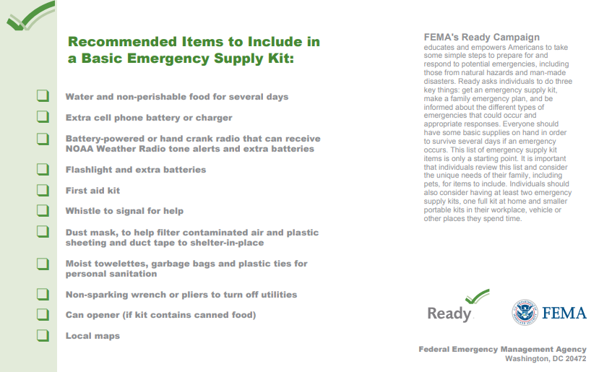
You can prepare by doing the following ahead of time:
Always have enough water available to meet the hydration and hygiene needs of everyone in your household for about three days (don’t forget to consider your bowel/bladder care needs!)
Detailed recommendations for a basic disaster supplies kit can be found at: https://www.ready.gov/kit

Slide 42
You can prepare by doing the following ahead of time:
PWC user: Consider purchasing a extra battery
Have a manual wheelchair as a back-up option (it will also be easier to transport in a regular vehicle)
Show others how to operate, assemble, and dissemble wheelchair
Have a plan to get out of town if necessary, including:
Identify and communicate with people who expect you to come stay with them in the event of an emergency
Make sure you have written/printed directions to their homes
Google Maps may not be an option, and some roads may be closed!

Slide 43
You can prepare by doing the following ahead of time:
Medications:
Keep up-to-date on your medication refills
Keep a list of your prescription medicines including information on dosage, frequency, medical supply needs and allergies.
Have a cooler and chemical ice packs for all refrigerated medication
Talk to MD and pharmacist about how to create an emergency supply of medications
What about money?
If the power is out ATMs and credit card readers may not be working. Keep enough cash on hand to get you out of town!

Slide 44
Resources
www.cdc.gov/ncbddd/disabilityandhealth/emergencypreparedness.html
Centers for Disease Control and Prevention (CDC)
Disability and health, emergency preparedness articles available here
www.CTIA.org
The Wireless Association
Provides information about wireless emergency alerts for your smart phone
www.fcc.gov
Federal Communications Commission
Provides information about the Emergency Alert System (EAS)
www.fema.gov
Federal Emergency Management Agency

Slide 45
Resources
www.gema.state.ga.us
Georgia Emergency Management Agency/Homeland Security
www.nfpa.org/disabilities
National Fire Protection Association.
A Personal Emergency Evacuation Planning Checklist can be found at this website
www.nws.noaa.gov/nwr
National Oceanic and Atmospheric Administration
Provides information about weather radio stations and weather radios
www.ready.ga.gov
Ready Georgia
A statewide campaign supported by the Georgia Emergency Management Agency (GEMA) aimed at motivating Georgians to take action to prepare for a disaster.

Slide 46
Resources
www.usfa.fema.gov
U.S. Fire Administration
www.ready.gov
Ready
Detailed recommendations for a basic disaster supplies kit can be found at www.ready.gov/basic-disaster-supplies-kit
www.redcross.org
American Red Cross
Provides information about local shelters in the event of a community emergency
www.shepherd.org/resources/rescue
Shepherd Center.
Additional information about the RESCUE program (and the packet you received) can be found at this website.

Slide 47
There are smart phone apps for that!
American Red Cross
First Aid by American Red Cross
step-by-step instructions to guide you through everyday first aid scenarios.
Integrated with 911 so you can call EMS from the app.
Available in English and Spanish languages
Emergency! by American Red Cross
Audible siren for alerts related to tornados, hurricanes, floods, and many other weather-related emergency situations
Information on what to do before/during/after the event
Track the event
Enable critical alerts that can override the Do Not Disturb setting on your device
Let family and friends know your are okay with the “I’m Safe” alert for Facebook, Twitter, email and text
Find open Red Cross shelters in your area when you need help
Available in English and Spanish languages

Slide 48
Ready Georgia: https://gema.georgia.gov/plan-prepare/ready-georgia
A national public service advertising (PSA) campaign designed to educate and empower Americans to prepare for and respond to emergencies including natural and man-made disasters.
Create and edit your Ready Profile for customized emergency plans
Local weather and public health alerts
Checklist of emergency supplies/kit
Information on what to do during different types of emergencies
Hurricane evacuation routes
Disaster history for your location
Maps of nearby American Red Cross shelters

Slide 49
General apps available
Emergency contacts
Keeps a list of emergency contacts, known allergies, medications you are on, any conditions you have, and your personal identification information on your smart phone.
Emergency GPS locators
Built into your phone and can be used in emergency situations to report your GPS position to first responders or family/friends
Can install GPS apps for more detailed tracking information
Notes:
Some of these are free, and some entail a fee. We don’t endorse any over the others, and there are lots of variations out there. Get on the app store on your smart phone and see what looks good to you!

Slide 50
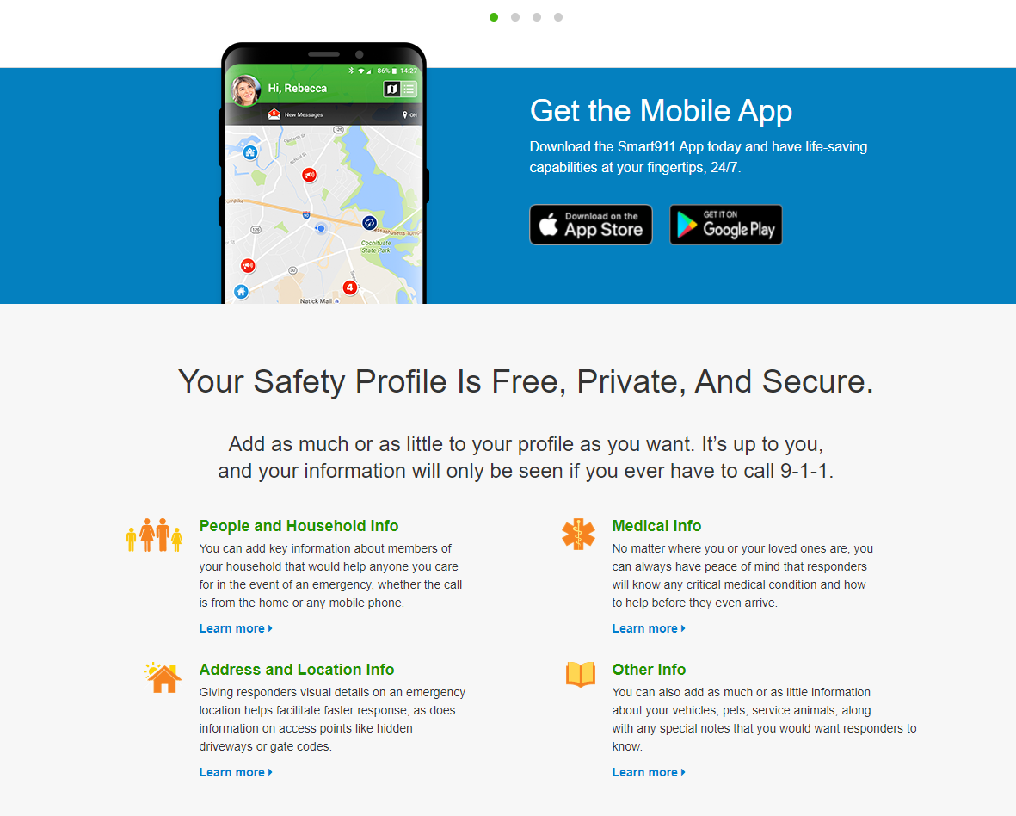
www.smart911.com
Smart911 is a free service that allows citizens across the U.S. to create a Safety Profile for their household that includes any information they want 9-1-1 to have in the event of an emergency.
Anyone in that household dials 9-1-1 from a phone associated with their Safety Profile, their profile is immediately displayed to the 9-1-1 call taker providing additional information that can be used to facilitate the proper response to the proper location.

Slide 51
Health App- IOS
The Health app was created to help organize your important health information and make it easy to access in a central and secure place.
There are new ways to share data with your loved ones and healthcare team.
Create a medial ID to allow first responders to access your critical medical information from the Lock Screen and/or shared during an emergency call.

Slide 52
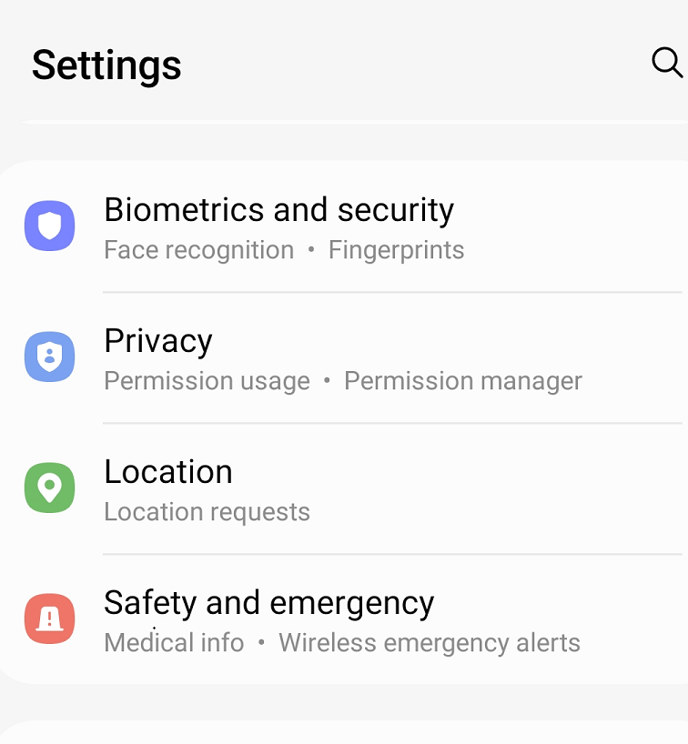
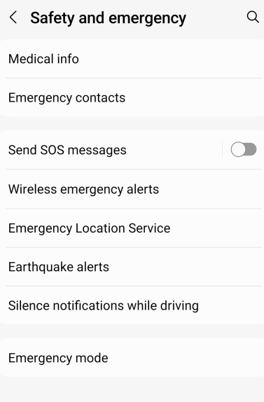
Android
Go to Settings-Safety and Emergency
Add Medical Info and Emergency Contacts

Slide 53
To recap, when you get home from Shepherd please contact:
Fire Safety:
Develop your escape plan
Check smoke detectors
Your local fire department
Discuss escape plan and let first responders know what your needs are
Emergency Preparedness:
Register with the Emergency Management Agency for your county
Allow the American Red Cross to be able to accommodate your evacuation needs if a community disaster occurs
Contact your utility company

Slide 54
Thank you!

