Slide 1
Wellness for life
Staying active and preventing complications post neurological injury/illness

Slide 2
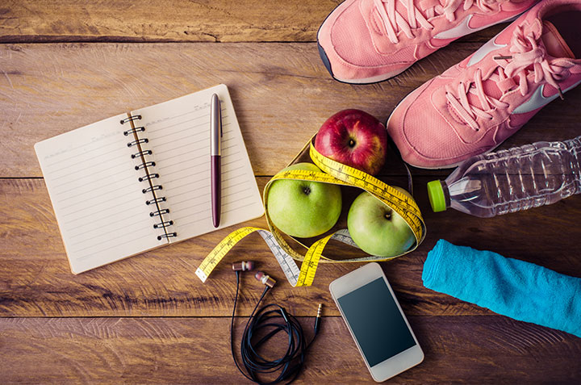
What is Wellness?
According the National Wellness Institute is:
A conscious, self directed, and evolving process of achieving full potential.
Multidimensional, holistic, and encompassing lifestyle.
Positive and affirming.

Slide 3
Question:
Does this match your personal definition of wellness?
What is the same?
What is different?

Slide 4
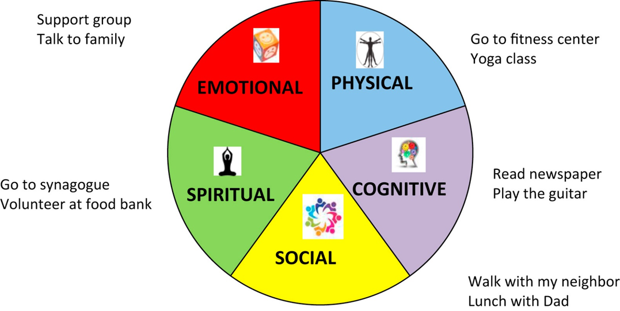
Dimensions of Wellness
Social
Physical
Emotional
WELLNESS
Spiritual
Vocational
Intellectual

Slide 5
Emotional Wellness
Awareness, understanding, and acceptance of your emotions, and your ability to manage effectively through challenges and changes. These can be both positive and negative challenges and changes.
Empathy
Thinking about what you do before you do it.
Talking about your feelings.

Slide 6
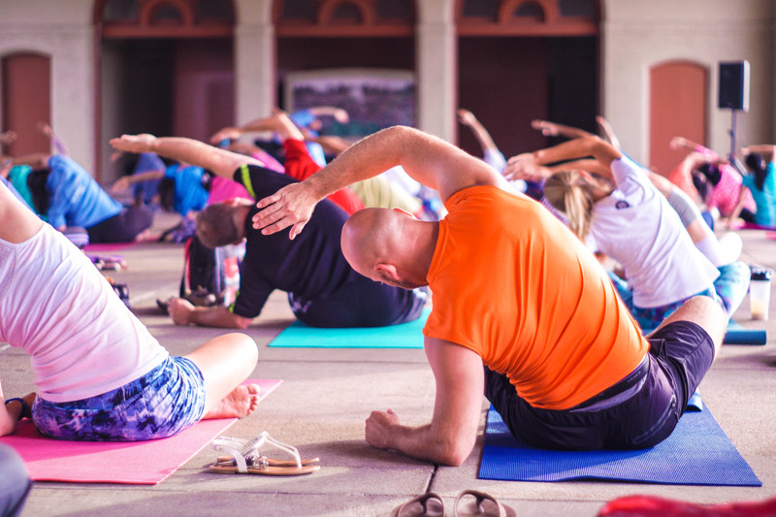
Physical wellness
Recognizing the need for physical activities, healthy foods, sleep, as well as preventing illness/injury and managing chronic health conditions.
Eating a well-balanced diet
Participating in physical activities.
Getting regular medical check up
Taking care of yourself.

Slide 7
Cognitive wellness
Recognizing one’s creative abilities and finding ways to expand knowledge and skills.
This is learning, doing, and experiencing the activities that you find interesting and enjoyable!
Outdoor activities, arts, sports, crafting. You name it!!
Have FUN!!!!

Slide 8
Social Wellness
Developing a sense of connection, belonging and a well-developed support system.
Friends
Family members
Social networking
Your community

Slide 9
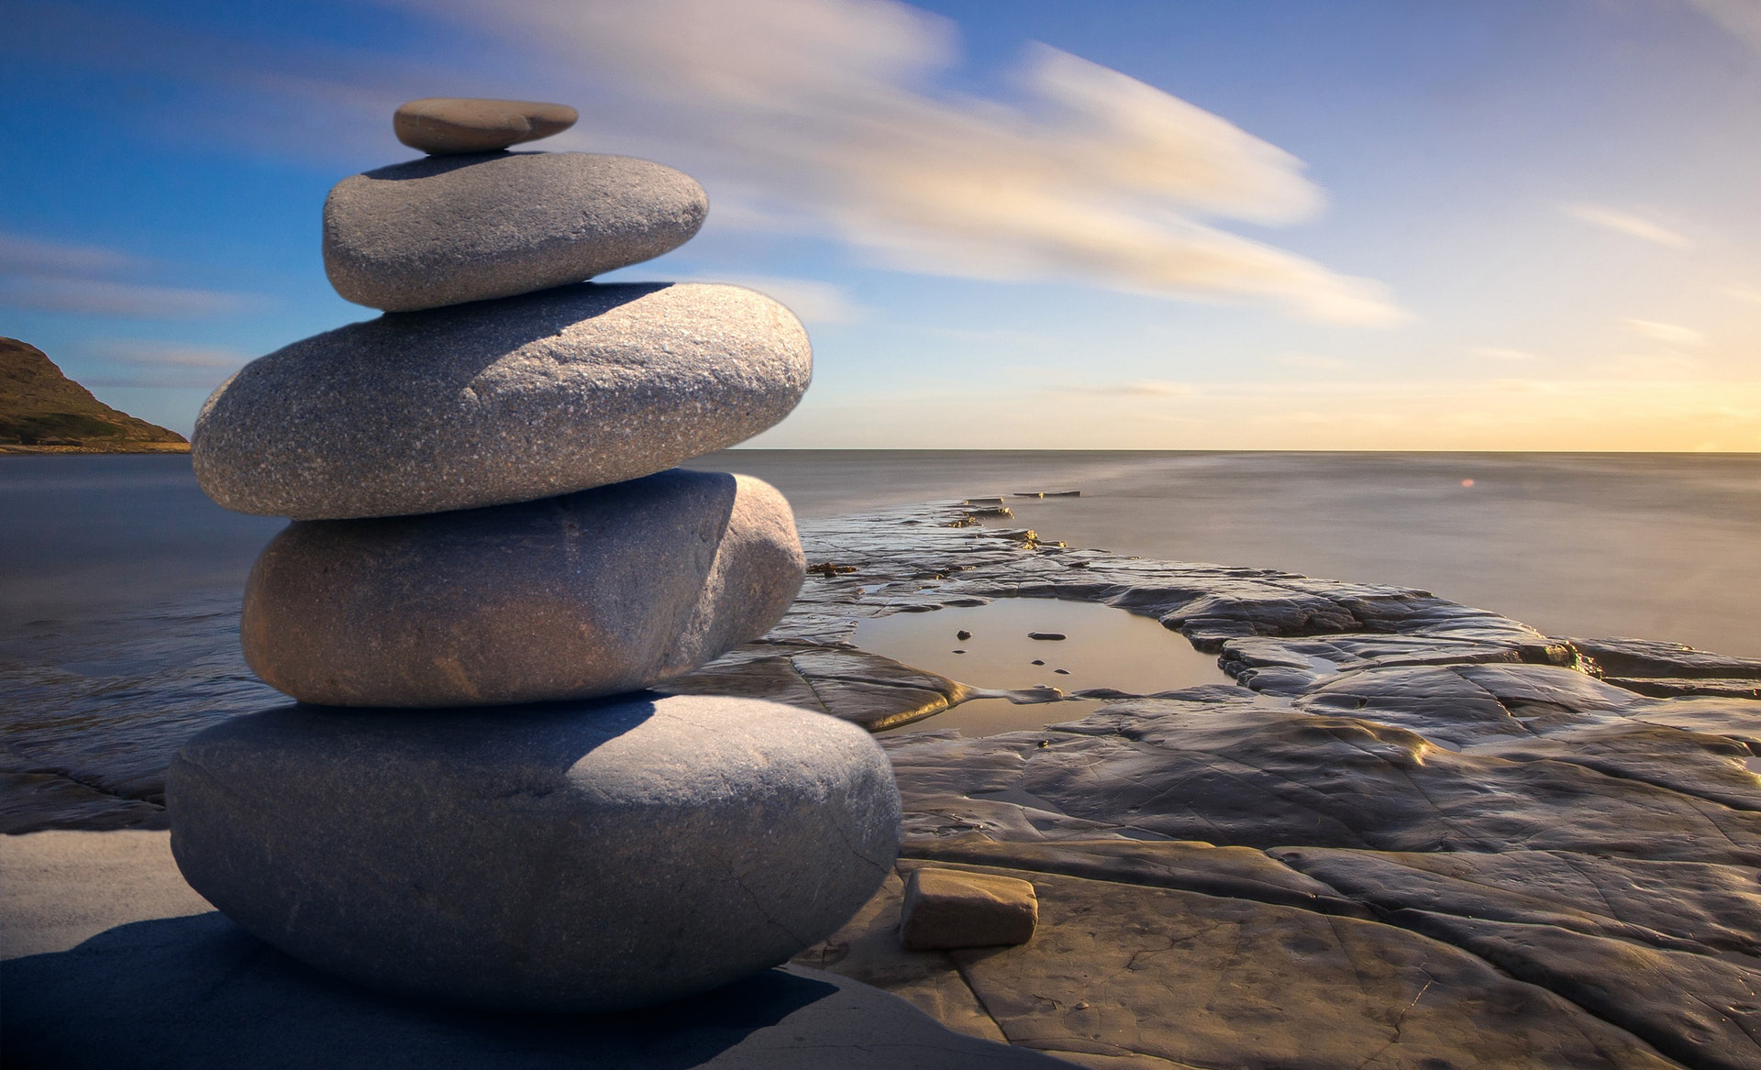
Spiritual Wellness
Expanding a sense of purpose and meaning in life, including one’s morals and ethics. This may or may not involve religious activities.
Personal reflection
Organized and non organized religious practices
Spending time in nature
Meditation

Slide 10
Preventing complications
Respiratory
COMPLICATIONS WELLNESS ACTIONS
1. Pneumonia Breathing exercises
(physical, spiritual, emotional)
2. Pulmonary embolism Get up and get active
(physical, social, emotional)

Slide 11
Preventing complications
Bladder/Bowel
COMPLICATIONS WELLNESS ACTIONS
1. Accidents Find a toileting schedule that works for you! (physical, spiritual, emotional)
2. UTIs Always be prepared with extra supplies
(physical, social, emotional)
Practice catherization in the community (physical, social)
Nutrition (physical, emotional)

Slide 12
Preventing complications
Skin
COMPLICATIONS WELLNESS ACTIONS
1. Pressure sore Weight shifts
(physical)
2. Shearing Skin checks
(physical)
Avoid weight gain
(physical, emotional, social)

Slide 13
Preventing complications
Mental Health
COMPLICATIONS WELLNESS ACTIONS
1. Depression Get connected
(emotional, social, spiritual)
2. Anxiety Get involved
(social, emotional)
Seek counseling
(emotional)
Don’t change meds without care of doctor (physical)

Slide 14
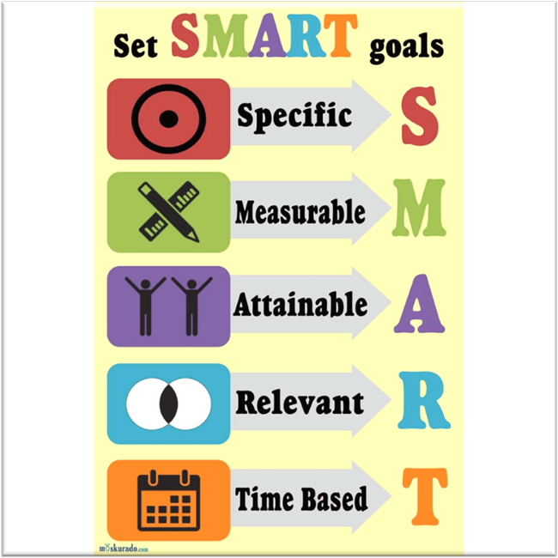
Now what?
Make a personal wellness plan:
A wellness plan is plan of action geared towards your well-being.
Takes in account all dimensions of wellness.
Uses S.M.A.R.T goals.

Slide 15
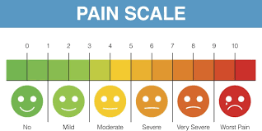
How to make a wellness plan (in 5 easy steps)
Step 1: Identify the dimensions that could use improvement.
Give each area a ranking from 1-10, with 1 being the poorest/lowest rank and 10 being the best/highest rank.
When doing this, be honest with yourself and don’t judge yourself because of low rankings.

Slide 16
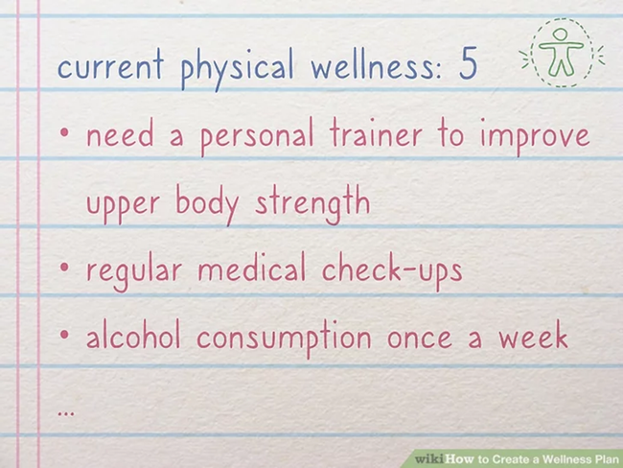
How to make a wellness plan
Step 2: Set S.M.A.R.T goals.
Specific goals you want to accomplish
Measurable
Action orientated
Relevant
Time based
For example: I will lose 20lbs by going to the gym/home 4 times a week, by doing cardio, strength training, cutting back on sugar, and controlling portion sizes. I will know I am making progress because I will lose 2lbs a week for 10 weeks.

Slide 17
Practice writing a S.M.A.r.t goal
Now it’s practice time! Let’s all write out one SMART goal
Use the template:
I will (goal here) by (how will you measure the goal) by (how will you do the goal). I will know I am making progress because (how to see the progress) for (time goes here).

Slide 18
Practice writing s.m.a.r.t goals
Specific: I will improve upper body strength
Measurable: By going to the gym 4 times a week
Action: Completing strength training exercises.
Relevant: I know I am progressing as I will increase the number of reps (or resistance or weight) 1 time every 2 weeks.
Time bases: For 12 weeks.

Slide 19
How to make a wellness plan
Step 3: Keep track of your progress
Use a calendar or App designated for tracking your progress.
Seeing the progress of what you have completed is great motivation!
Do regular personal assessments: Are you feeling happier, do you have more energy, more fun or laughter filled moments, etc.
Step 4: Update as needed
As you develop your personal wellness, you may notice that certain goals take more-or-less time than anticipated.
Make it a point to monitor your progress and reassess every 1-3 or 3-6 months.
Set a reminder in your phone or write in calendar for goal assessment.

Slide 20
How to make a wellness plan
Step 5: Get support
Having the support of others can be crucial to maintaining your drive and motivation
Get professional help/advice where needed
Join a support group
Start a “buddy system” with a friend, family member or various aspects of your wellness plan

Slide 21
Apps to help with wellness tracking
Strides Habitica
Way of Life Streaks

Slide 22
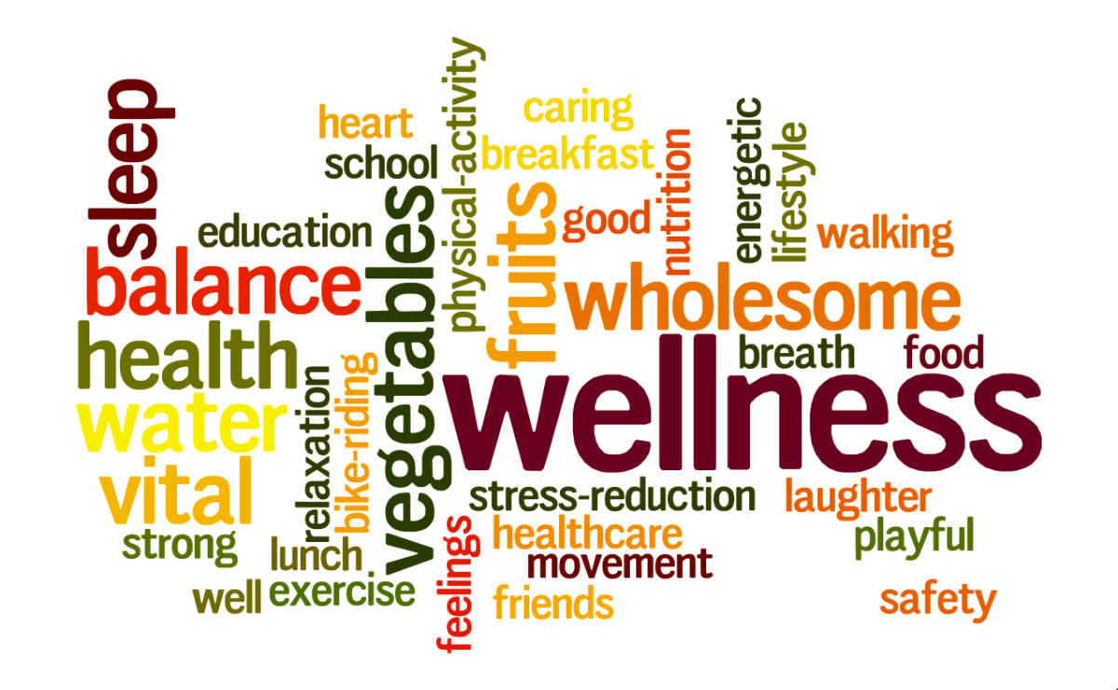
Questions or need assistance?
Contact:
Jenny DiLaura MA, CCLS, CTRS
Email (best form of communication):
Jenny.dilaura@shepherd.org
Office phone: 404-603-5173

